Slide 1

Scratch Beginners
Lesson 1

Slide 2

By the end of this unit…
You are going to learn how to write computer programs using a software package called Scratch.
You will create a computer game and test out each others’ games to decide what makes a good computer game.

Slide 3
Starter
Log onto your computer.
Find the program called Scratch.
Load it up.

Slide 4
Objective
Write the code to move a sprite
All of you will:
  Change the look of a sprite.
Most of you will:
  Make the sprite move.
Some of you will:
  Add further sprites and alter the speed that they move.

Slide 5
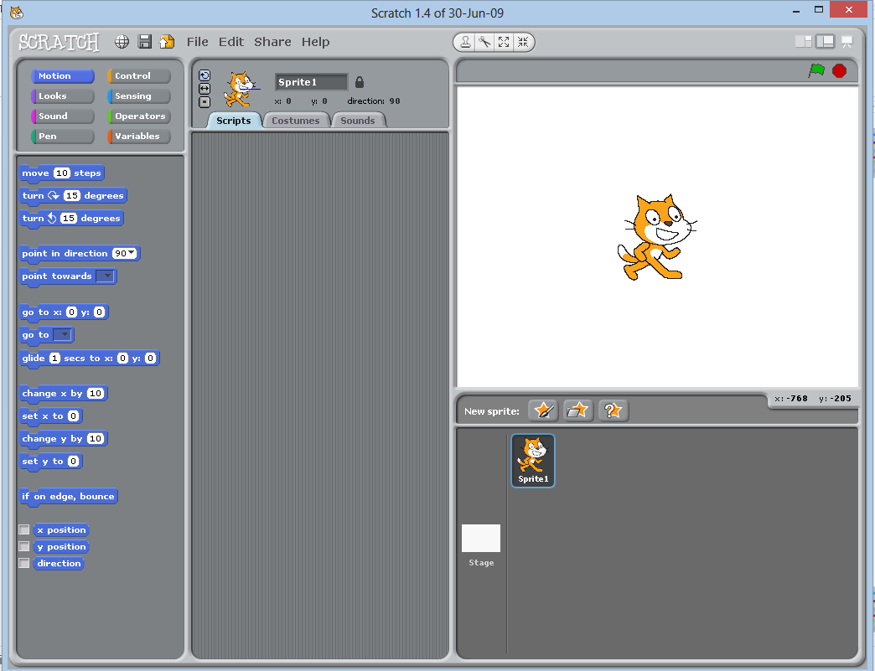
Scratch
Stage
Script Groups
Script Blocks
Sprite
Script Area

Slide 6


Slide 7

How much do you remember?
What is a sprite?
What is the stage?
How can you delete a sprite?
Which button can you use to add a sprite to the stage?
How can you change the folder you are looking at?

Slide 8
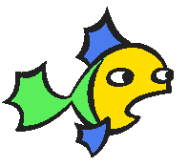
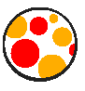
Over to you…
Delete the cat sprite.
Add the fish3 sprite.
Delete the fish3 sprite.
Add the beach ball sprite.
Delete the beach ball sprite.
Add any sprite of your choice.

Slide 9


Slide 10
How much do you remember?
In which group of scripts would you find the option for “When space key is pressed”?
In which group of scripts would you find “Move 10 steps”?
How can you stop your sprite going off the edge of the screen?
How can you stop your sprite from turning upside down?

Slide 11

Changing the speed
To make the sprite go faster or slower, change the number of steps it moves.
What happens when it moves 3 steps?
What happens when it moves 20 steps?
Work out how you can get your sprite to move and turn using the turn option.

Slide 12

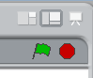
What will this code do?
This time we have a “Forever” loop in our script
When you press the space bar the sprite will keep moving, even after you release the spacebar.
Try it out.
Use the stop button to stop the sprite from moving.
Stop button

Slide 13



Over to you…
Add a second sprite of your choice.
Make it move at a different speed to your first sprite.
Work out how you can make that sprite move when you press the up arrow rather than the space bar.
Add another sprite which starts to move when you press a different button.

Slide 14
How much do you remember?
What is a sprite?
Which script group will allow you to move a sprite?
Which script group will allow you to choose how a script starts?
How can you stop a script from running?
What does the forever loop do?
How can you stop a sprite from going over the edge of the stage?
How can you change the speed that a sprite moves?

Slide 15
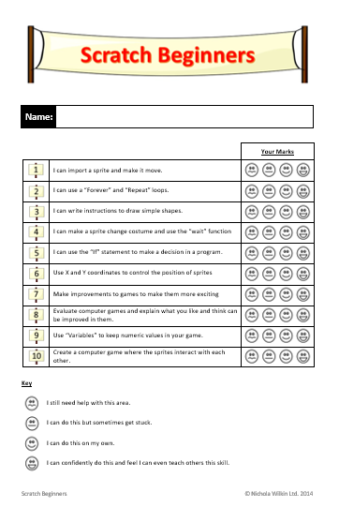

What skills have you practised today?
New skills you have learnt today…

