Slide 1
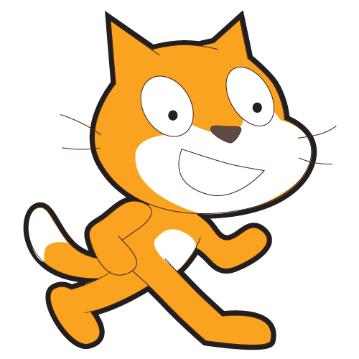
Scratch Beginners
Lesson 4

Slide 2
Starter
Load Scratch.
Change your sprite.
Add a background.
Make the sprite point towards your mouse pointer and chase it around the stage.

Slide 3
Objective
Use the If statement
All of you will:
  Write script that will run when the sprite touches a particular colour.
Most of you will:
  Write script that will run when one script touches another.
Some of you will:
  Create a complex game which includes further sprites and scripts.

Slide 4
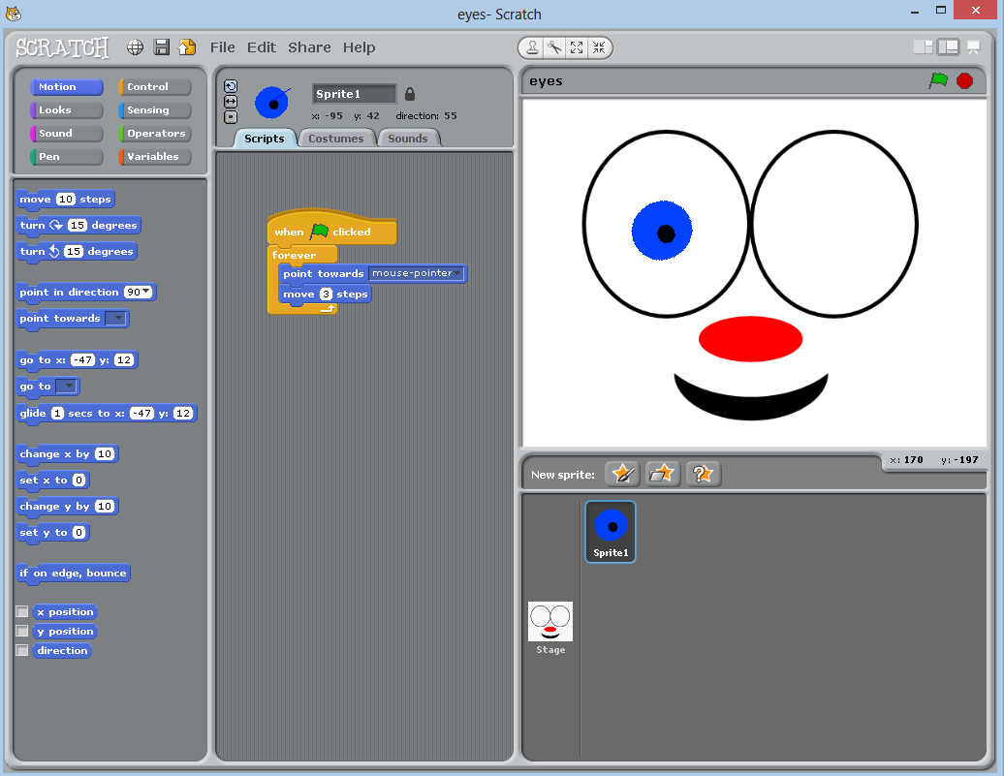
Load the file
Open the Eyes file.

Slide 5


Slide 6

How much do you remember?
What does the program do when it
is first loaded up?
What is the problem with the program?
Where would you find the “If” script?
Where would you find the “Touching colour” script?
What should your script do if the sprite touches the edge of the eye socket?

Slide 7

Over to you…
Complete the script to make the pupil sprite work correctly.
Duplicate the sprite and place the second pupil in the other eye socket.

Slide 8
Start a new project
Start a new Scratch project; you may want to save your Eyes project first.
Add two sprites.
Change the background to one of your choice.
Add the script so that one sprite moves backwards and forwards across the stage and bounces off the edge and the other sprite follows the mouse pointer.

Slide 9
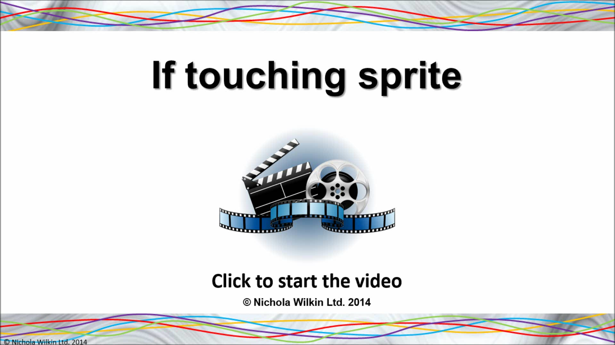

Slide 10

How much do you remember?
What do we want the program to do?
How do you stop a sprite turning upside down?
Why should you change the names of the sprites?
How can you change the names of the sprites?
Where would you find the “If” script?
Where would you find the “Touching” script?

Slide 11
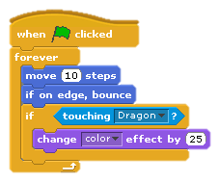
Over to you…
Rename your sprites.
Complete your game so that one sprite will change colour when it touches the other sprite.
Try to make your game more interesting by:
  Adding further sprites
  Adding different effects when they touch the other sprites.

Slide 12
Look at other peoples’ games
Have a look at the games that your classmates have created.
What do you like about them?
What did people do that was different to your game?
If you got stuck, what did you
do to help yourself solve the
problem?

Slide 13
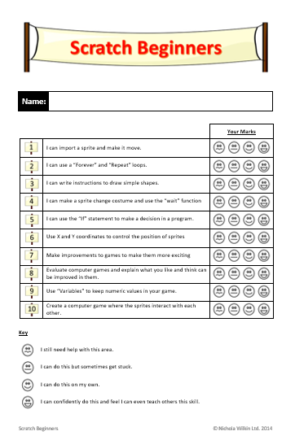




What skills have you practised today?
New skills you have learnt today…
Revisit skills from another lesson…

