Slide 1
Natural disasters – earthquakes
Subtitle

Slide 2
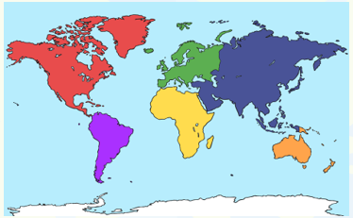
Continents
Can you remember the names of the continents?

Slide 3
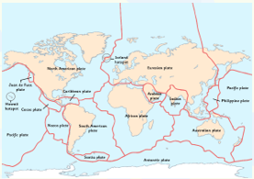
Tectonic plates
The Earth’s surface is called the crust.
It is made up of different rocky sections called tectonic plates.
Tectonic plates can move about on the softer mantle underneath them.
Try cutting your world map to show the tectonic plates.

Slide 4
Continental Drift
In 1910, a German Scientist called Alfred Wegener was the first to study that the continents used to be joined together.
The continents and ocean floors really do “float” on moving rock plates, and have been drifting for millions of years.
https://www.classzone.com/books/earth_science/terc/content/visualizations/es0806/es0806page01.cfm?chapter_no=visualization

Slide 5
But what has this got to do with earthquakes?
Earthquakes are vibrations caused by earth movements at plate margins and at major fault lines (cracks in the Earth’s surface).
They occur at plate margins but the plates can move in different ways. Let’s look at some.

Slide 6
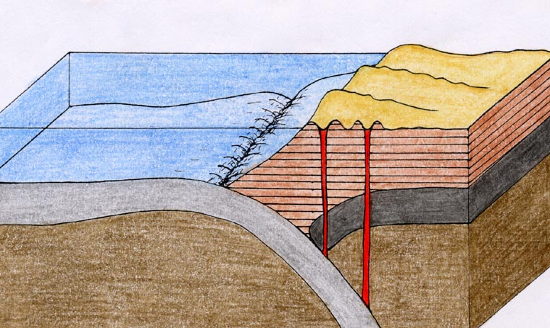
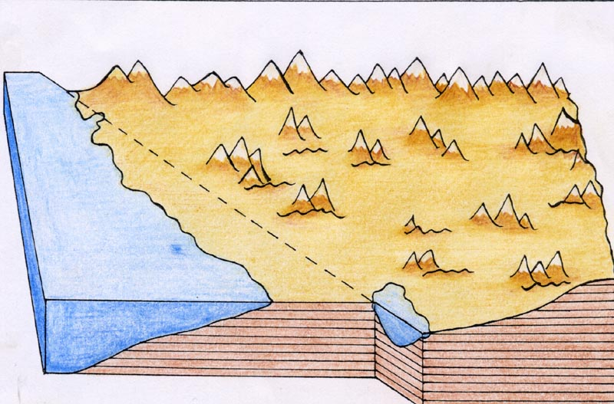
Destructive and conservative plates
Mr Kipling cakes…

Slide 7

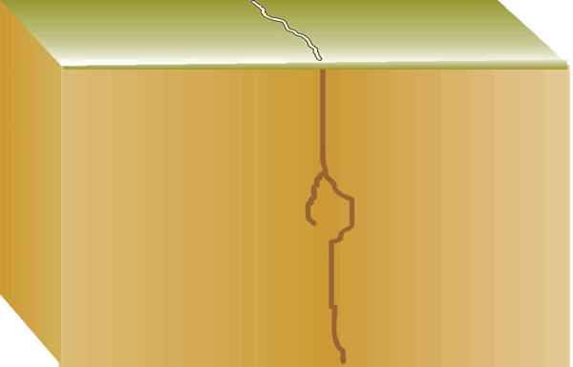
Why do earthquakes exist?
When two plates struggle to move past each other, they get locked.
Friction causes pressure to build up.
Suddenly, the pressure is released and the plates jolt into a new position.
This releases seismic waves and the vibrations they cause are called an earthquake.

Slide 8
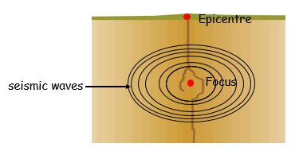
The focus and the epicentre

Slide 9
How are earthquakes measured?
The Richter Scale measures how powerful an earthquake is using an instrument called a seismograph.
The Richter Scale is measure from a scale of 1 – 10.
The largest earthquake recorded was 8.9 in Chile.

Slide 10
Why are some places more affected than others?
If a country is located on a plate boundary, then they will be affected by earthquakes as it is the build up of energy and friction between two plates being released.
Some countries have planned and built specifically because they know that their country is prone to earthquakes.
Let’s look at these…

Slide 11
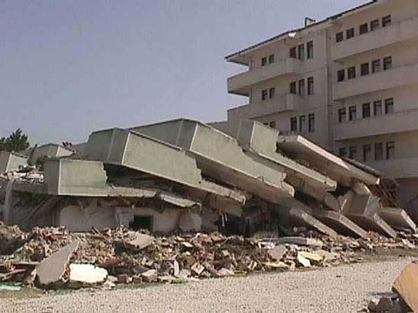
Izmit Earthquake 1999
Magnitude 7.4
170,000 people were killed
Their buildings were built from cement and sea shells, which meant they were incredibly unstable. This left 500,000 people homeless.

Slide 12
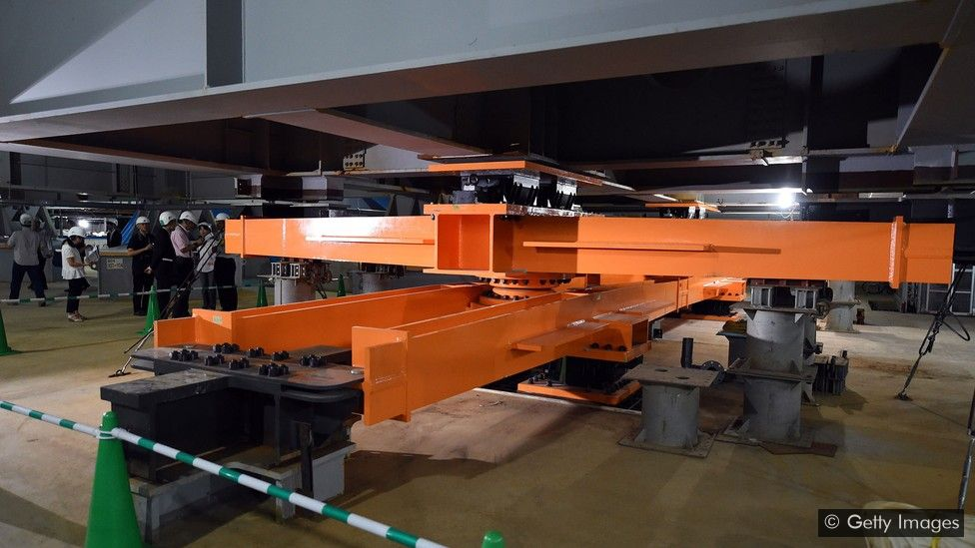
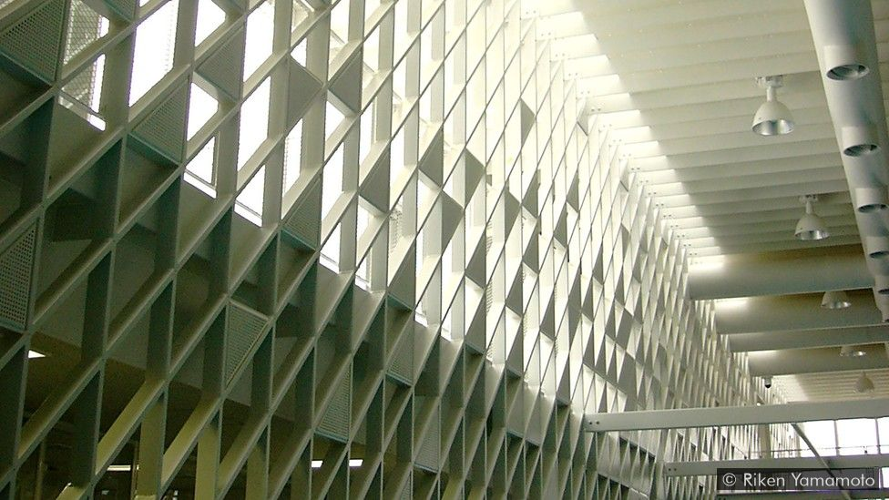
Japanese buildings
Japanese skyscrapers have shock absorbers.
Japanese skyscrapers also have a protective mesh.

Slide 13
Earthquake challenge
You are going to become engineers, deciding the best types of buildings to survive an earthquake.
You will make wide and small buildings, tall and skinny buildings and larger buildings, deciding which will sustain seismic waves better than others.

