Slide 1
Natural Disasters - Volcanoes

Slide 2
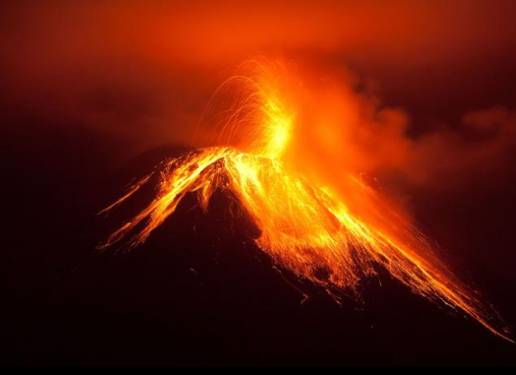
What is a volcano?
https://www.curriculumbits.com/prodimages/details/geography/natural-disasters-volcanoes.html

Slide 3
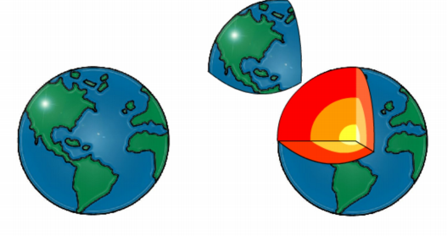
What is the Earth made of?
The crust
The Mantle
The outer core
The inner core

Slide 4
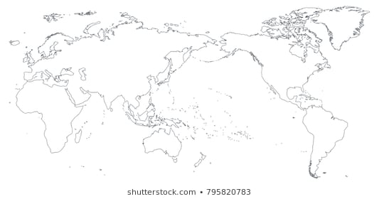
Where are volcanoes found?
Find the following active volcanoes and mark them with an X on your map.
Santa Maria – Guatemala
Sakurajima – Japan
Galeras – Colombia
Mount Merapi – Indonesia
Taal Volcano – Phillipines
Mount Nyiragongo – Congo
Mount Vesuvius – Italy
Eyjafjallajokull – Iceland
Mount Loa - Hawaii

Slide 5
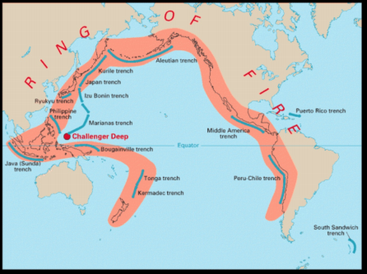
The Ring of Fire
The Ring of Fire is home to the most naturally volatile places in our planet. 90% of the world’s earthquakes occur here. In addition to that, it is where you can find 75% of the Earth’s volcanoes.

Slide 6
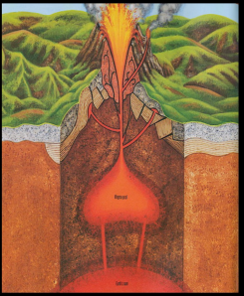
How is a volcano formed?
Deep in the Earth it is very hot. It is so hot that rocks melt. The melted rock is called magma. Heat rises so the magma moves towards the Earth’s crust. Sometimes it finds a crack or hole in the earth’s crust and bursts through – this is how a volcano begins.

Slide 7
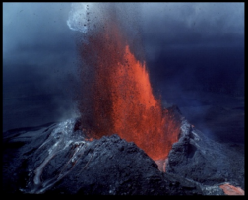
Volcanoes surface
At the surface it erupts to form lava flows and ash deposits. Ash deposits result from more explosive activity. Once the lava has erupted, it eventually dries to form rock. After many more eruptions you have a big volcano because of rock solidified from past eruptions.

Slide 8
Different types of volcanoes
Active – eruptions can be anytime and often
Dorman – has been a while since it has erupted but could erupt at any time.
Extinct – meaning it hasn’t erupted in a very long, long time and so it probably won’t ever erupt again.

Slide 9
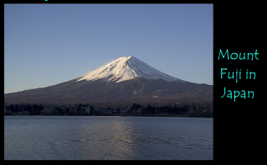
Composite Volcanoes
Composite volcanoes usually erupt in an explosive way. This is because the magma is quite sticky and it clogs up the conduit causing a massive build up of pressure. They are usually quite large and coned-shaped.

Slide 10
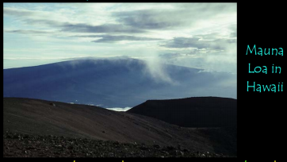
Shield Volcanoes
Shield volcanoes are volcanoes that erupt quite runny lava that travels over long distances before cooling. These create long, gentle slopes that resemble a warrior’s shield, hence the name. Lots of volcanic islands, such as Hawaii, were created by shield volcanoes. This type of volcano rarely explodes.

Slide 11
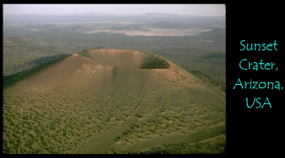
Cinder Cone Volcanoes
Cinder Cone Volcanoes are formed when lava fragments are ejected from the vent, that then cool quickly and form rock around the vent. They grow rapidly bur rarely grow above 250m in height. They are usually not dangerous unless you fall into one.

