Slide 1
Towards Successful Learning
Parent Information Session
We have embedded a programme called ‘Towards Successful Learning’ across the whole school. This programme is based upon a tried-and-tested model by Diana Pardoe* which focuses on supporting, and furthering the development of, successful learning and teaching in schools.

Slide 2
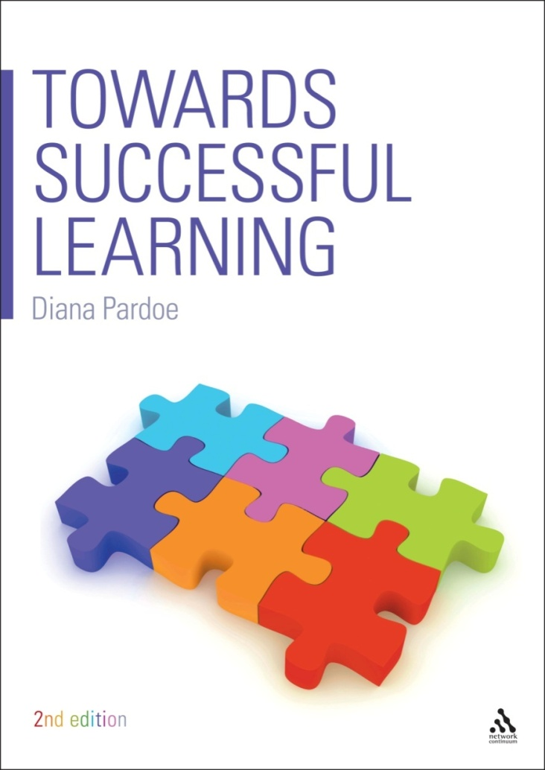
Diana Pardoe (Author of ‘Towards Successful Learning’) has more than 25 years teaching experience across primary and secondary key stages, her main area of expertise being the primary phase. She has been a Deputy Headteacher in a large primary school, has worked as an Assessment Consultant for Bristol LA and she spent 5 years working as a Learning Coach in an Excellence in Cities Action Zone in South Bristol. Diana has been involved in the professional development of teachers and support staff, leading courses, conferences and workshops for many years. She is now self employed and leading training and consultancy in learning and teaching across the country.

Slide 3
“How children feel about themselves as learners at the age of 11 will be the way they feel about themselves as learners into adult hood and effect their future learning choices”.
When learners are motivated and actively involved in their learning; when they talk meaningfully about how they learn; when they take more responsibility for themselves and their learning and understand that effort is the key to success….then they are more likely to make better progress, develop greater confidence and independence and become higher achievers.
Di Pardoe

Slide 4
Growing citizens of the 21st Century
We all want the very best for our children. They are growing up in a world that is changing so rapidly we have little idea about what their futures will be like! We therefore need to prepare them for change and challenge and provide them with the opportunities to be the best they can be.
What do we mean by learning success?
What do successful learners do?
What is real achievement?
How can we best promote and support learning at home?

Slide 5
Striving for a future where all learners...
have the opportunities to be the best they can be
have high levels of oral communication
are confident and motivated and embrace challenge
persevere and are resilient in the face of difficulties
use critical and creative thinking to solve problems
work collaboratively and independently
take responsibility for themselves and their learning

Slide 6
Towards Successful Learning...
…successful learners...
Who enjoy learning, make progress and achieve
…confident individuals...
who are able to live safe, healthy and fulfilling lives
…responsible citizens...
who make a positive contribution to society

Slide 7
What is a successful learner? (what parents say…)
Sits nicely
Gets all the right answers
Finishes the task
Doesn’t talk
Is interested in the task
Doesn’t need help from an adult
Gets stickers/rewards
Told they are doing a good job
Puts their hand up
Makes the teacher happy
Has a goal to work to
Finds work fun
Asks questions
Will persevere
Listens
Has a sense of pride

Slide 8
Uses team work skills
Shows working out
Is always ready
Does their homework
Never gives up
Has a go
Listens
Makes the right choices in class
Improves
Believes in themselves
Stays on task
Is always ready to learn
Finds out new things
Thinks hard
Tries hard
Works with a partner
Thinks hard
Isn’t afraid to ask
What children say…
Shares ideas
Takes turns
Helps others
Asks questions
Gets organised
Ignores distractions
Encourages others
Takes in information
Uses the spellings on the board
Has courage
Practises
A successful learner is someone who......

Slide 9
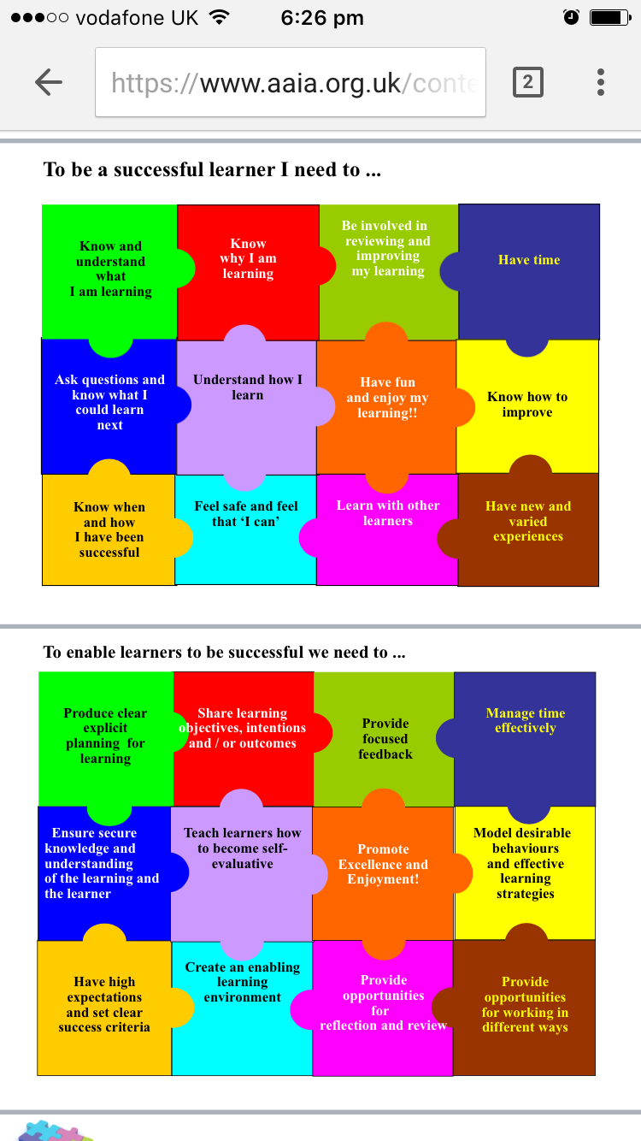

Slide 11
What does a
‘purple learner’ do?

Slide 12
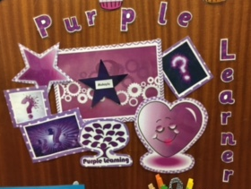
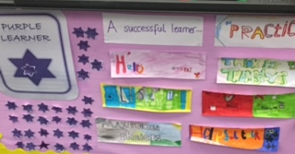
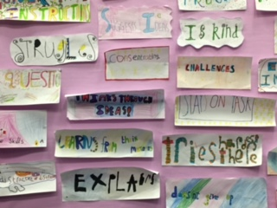
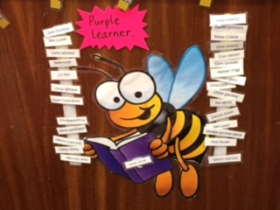
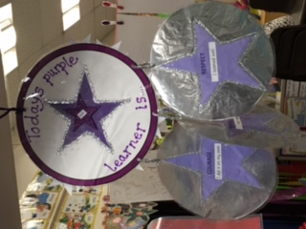
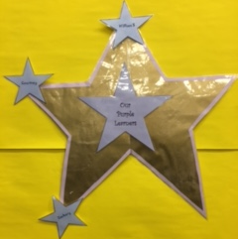
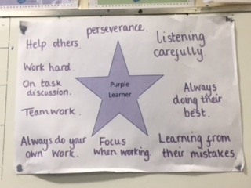
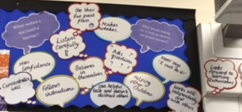

Slide 13
Sharing ideas
Giving instructions
Encouragement
Talking about our learning
Asking questions
Being polite
Explaining
Helpful Talk………..

Slide 14
Gossip
Arguing
Talking when someone else is talking
Back-chat
Chatting – when it’s not about our learning
Interrupting
Swearing
Unhelpful talk………….

Slide 15
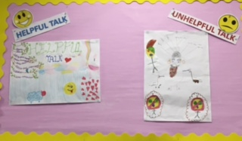
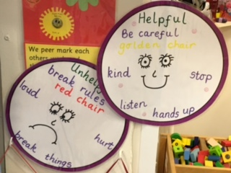
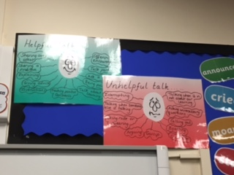
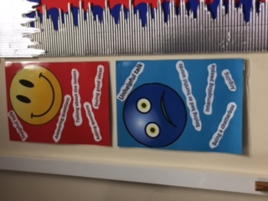

Slide 16

5 Point Plan!

Slide 17
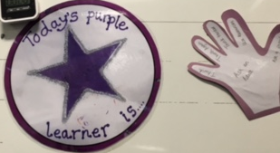
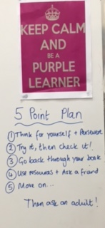
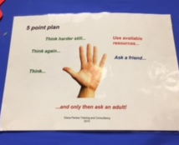
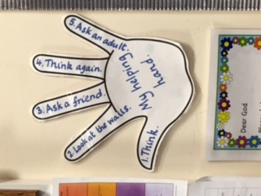

Slide 18
Feedback aims to reduce the gap between where the learner is and where s/he is aiming to be – between current achievement and success criteria
Feedback serves various purposes in reducing this gap –
prompting to capture attention and help with focusing on
the task
directing attention to the processes needed to accomplish the
task
providing information about what has been misunderstood
motivating to invest effort
(from Hattie - Visible Learning for Teachers 2012)

Slide 19

Feedback can have limited value if it is provided at a distance from the original learning
Placing real value on time for improvement raises the status and impact of feedback. We need to feel confident in focusing lessons on responses to feedback.
We are learning to...
consolidate
improve
share understanding
explore misunderstanding
practise
review
evaluate
recognise

Slide 20
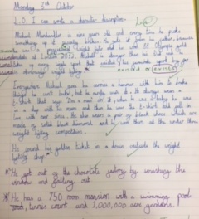

Slide 21
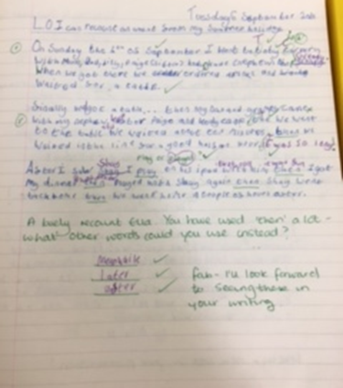

Slide 22
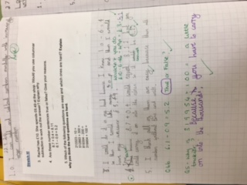
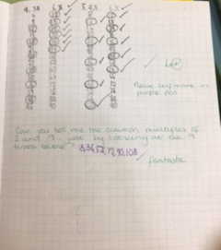

Slide 23
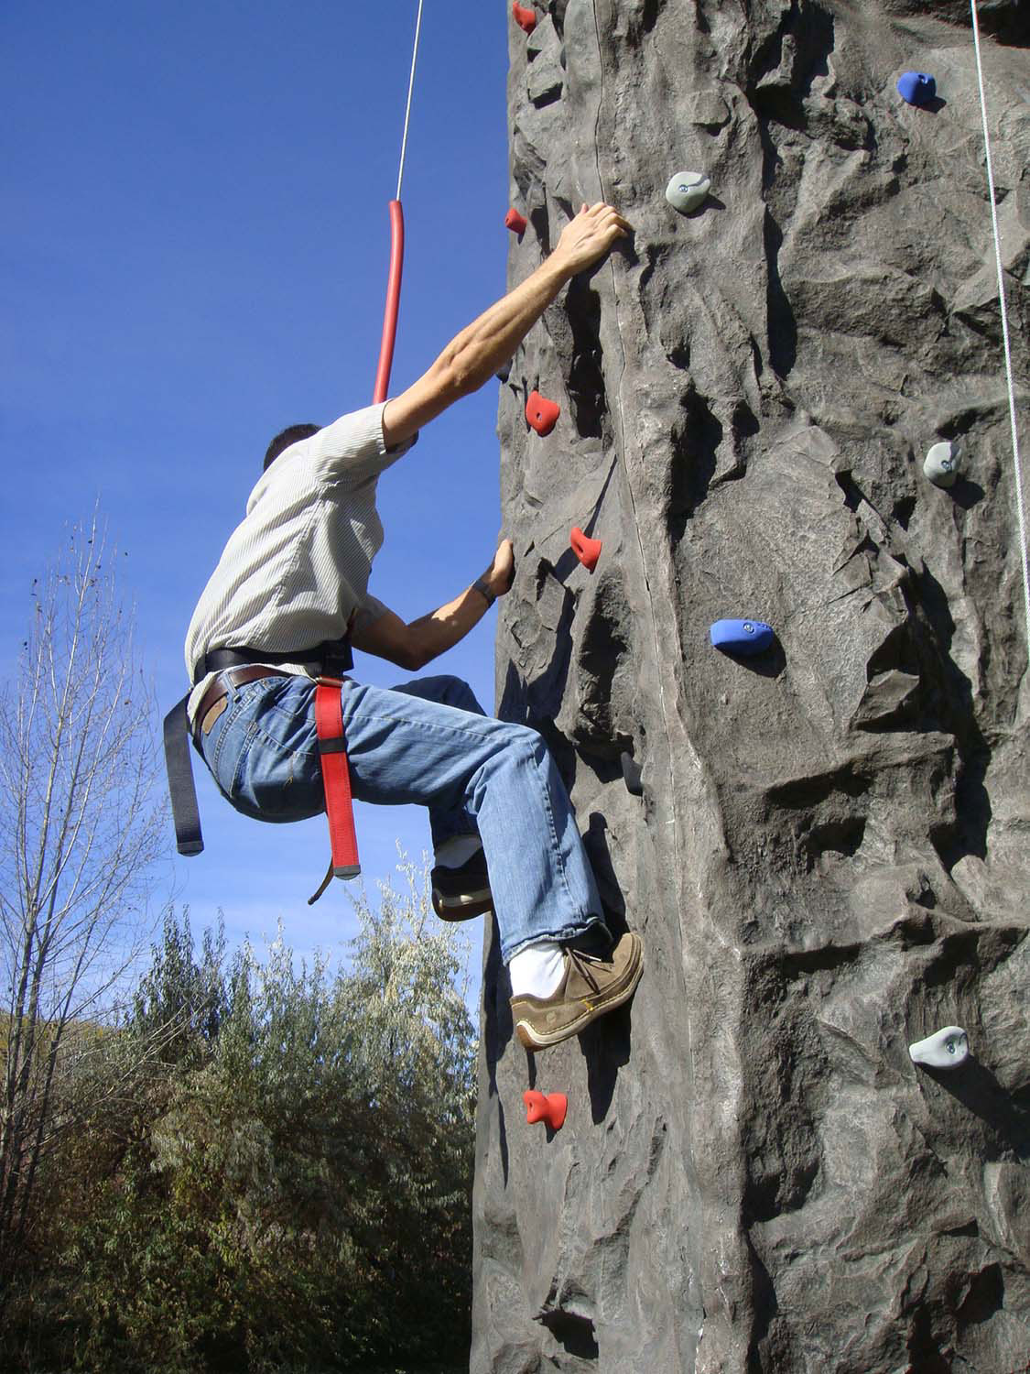
Challenge means…
something that is harder than you think
something difficult that is set for you to do
something that is hard but possible
have a go and think about it
try and try and try again
exciting but scary
doing hard stuff
something you can conquer!
© Di Pardoe Training and Consultancy 2014

Slide 24

Achievement means...
Beating your best
Surprising your self
Finishing something difficult
Feeling good inside
Doing something you‘ve been trying to do for ages
Overcoming a difficulty
© Di Pardoe Training and Consultancy 2014

Slide 25
A growth or ‘mastery’ mindset requires an orientation on learning...
where the focus is upon improving competence
A fixed mindset results from an orientation on performance...
where the focus is upon proving competence
Chris Watkins Institute of Education
Diana Pardoe Training and Consultancy 2015

Slide 26
Growth Mindset... | Fixed Mindset...
..leads to a desire to learn and therefore a tendency to... | ...leads to a desire to look ‘clever’ and therefore a tendency to...
embrace challenges I want to have a go at this because... | avoid challenges I don’t want to do this because...
persist in the face of obstacles and difficulty When something gets difficult I... What motivates you to do this? | give up easily When something gets difficult I... What would help you to think differently/have a go?
see effort as key to success When I try hard... | see effort as pointless When I try hard...
learn from all feedback When my teacher gives me feedback I feel.....because... | ignore useful or critical feedback When my teacher gives me feedback I feel.....because...
be inspired by the success of others I like to see my friends do well because... | feel threatened by the success of others I feel uncomfortable when my friends do well because...

Slide 27
Praise effort to develop a ‘mastery’ mindset
You’ve worked really hard on that – well done for keeping going even when it got difficult
Wow - look at how you’ve improved since last week
How would you like to show what you have learned?
Well done - you’re really pushing yourself today...
Every time you practise, you’re making connections in your brain stronger
Good - it’s making you think - that’s how your brain is growing!
This is a really valuable mistake. Let’s think about why it didn’t work and learn from it.

Slide 28
Any improvement requires change
Change involves doing something differently and moving out of the ‘comfort zone’
Change can be exciting or daunting; exhilarating or frightening
Change involves establishing new habits and practising them to establish a new norm
Definition of insanity:
‘Doing the same thing over and over again and expecting different results.’
Albert Einstein

Slide 29
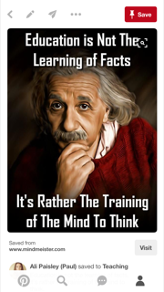
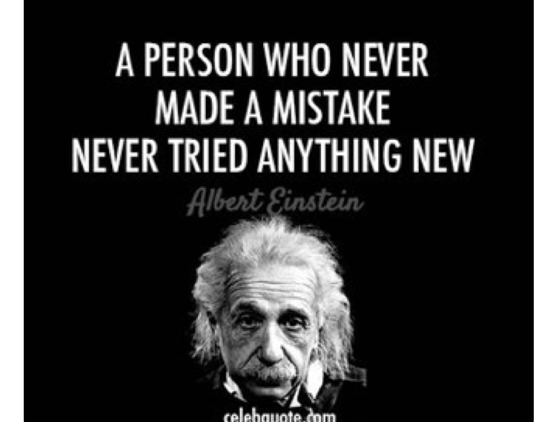
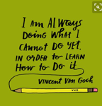

Slide 30
10 Questions you can ask to help develop a Growth Mindset in your children
What did you do today that made you think hard?
What happened today that made you keep on going?
What can you learn from this?
What mistake did you make that taught you something?
What did you try hard at today?
What strategy are you going to try now?
What will you do to challenge yourself?
What will you do to improve your work?
What will you do to solve this problem?
What will you do to improve your talents?
Remember to praise effort! Instead of saying ‘you're so clever’ Say…
You tried really hard on that!
You never gave up, even when it got hard!
You have really improved on…
What a creative solution to that problem!
I like/admire the way you are…
I can tell you have tried your best because…
Great thinking!
You remembered to…. well done!

Slide 31
Thank You!

