Slide 1
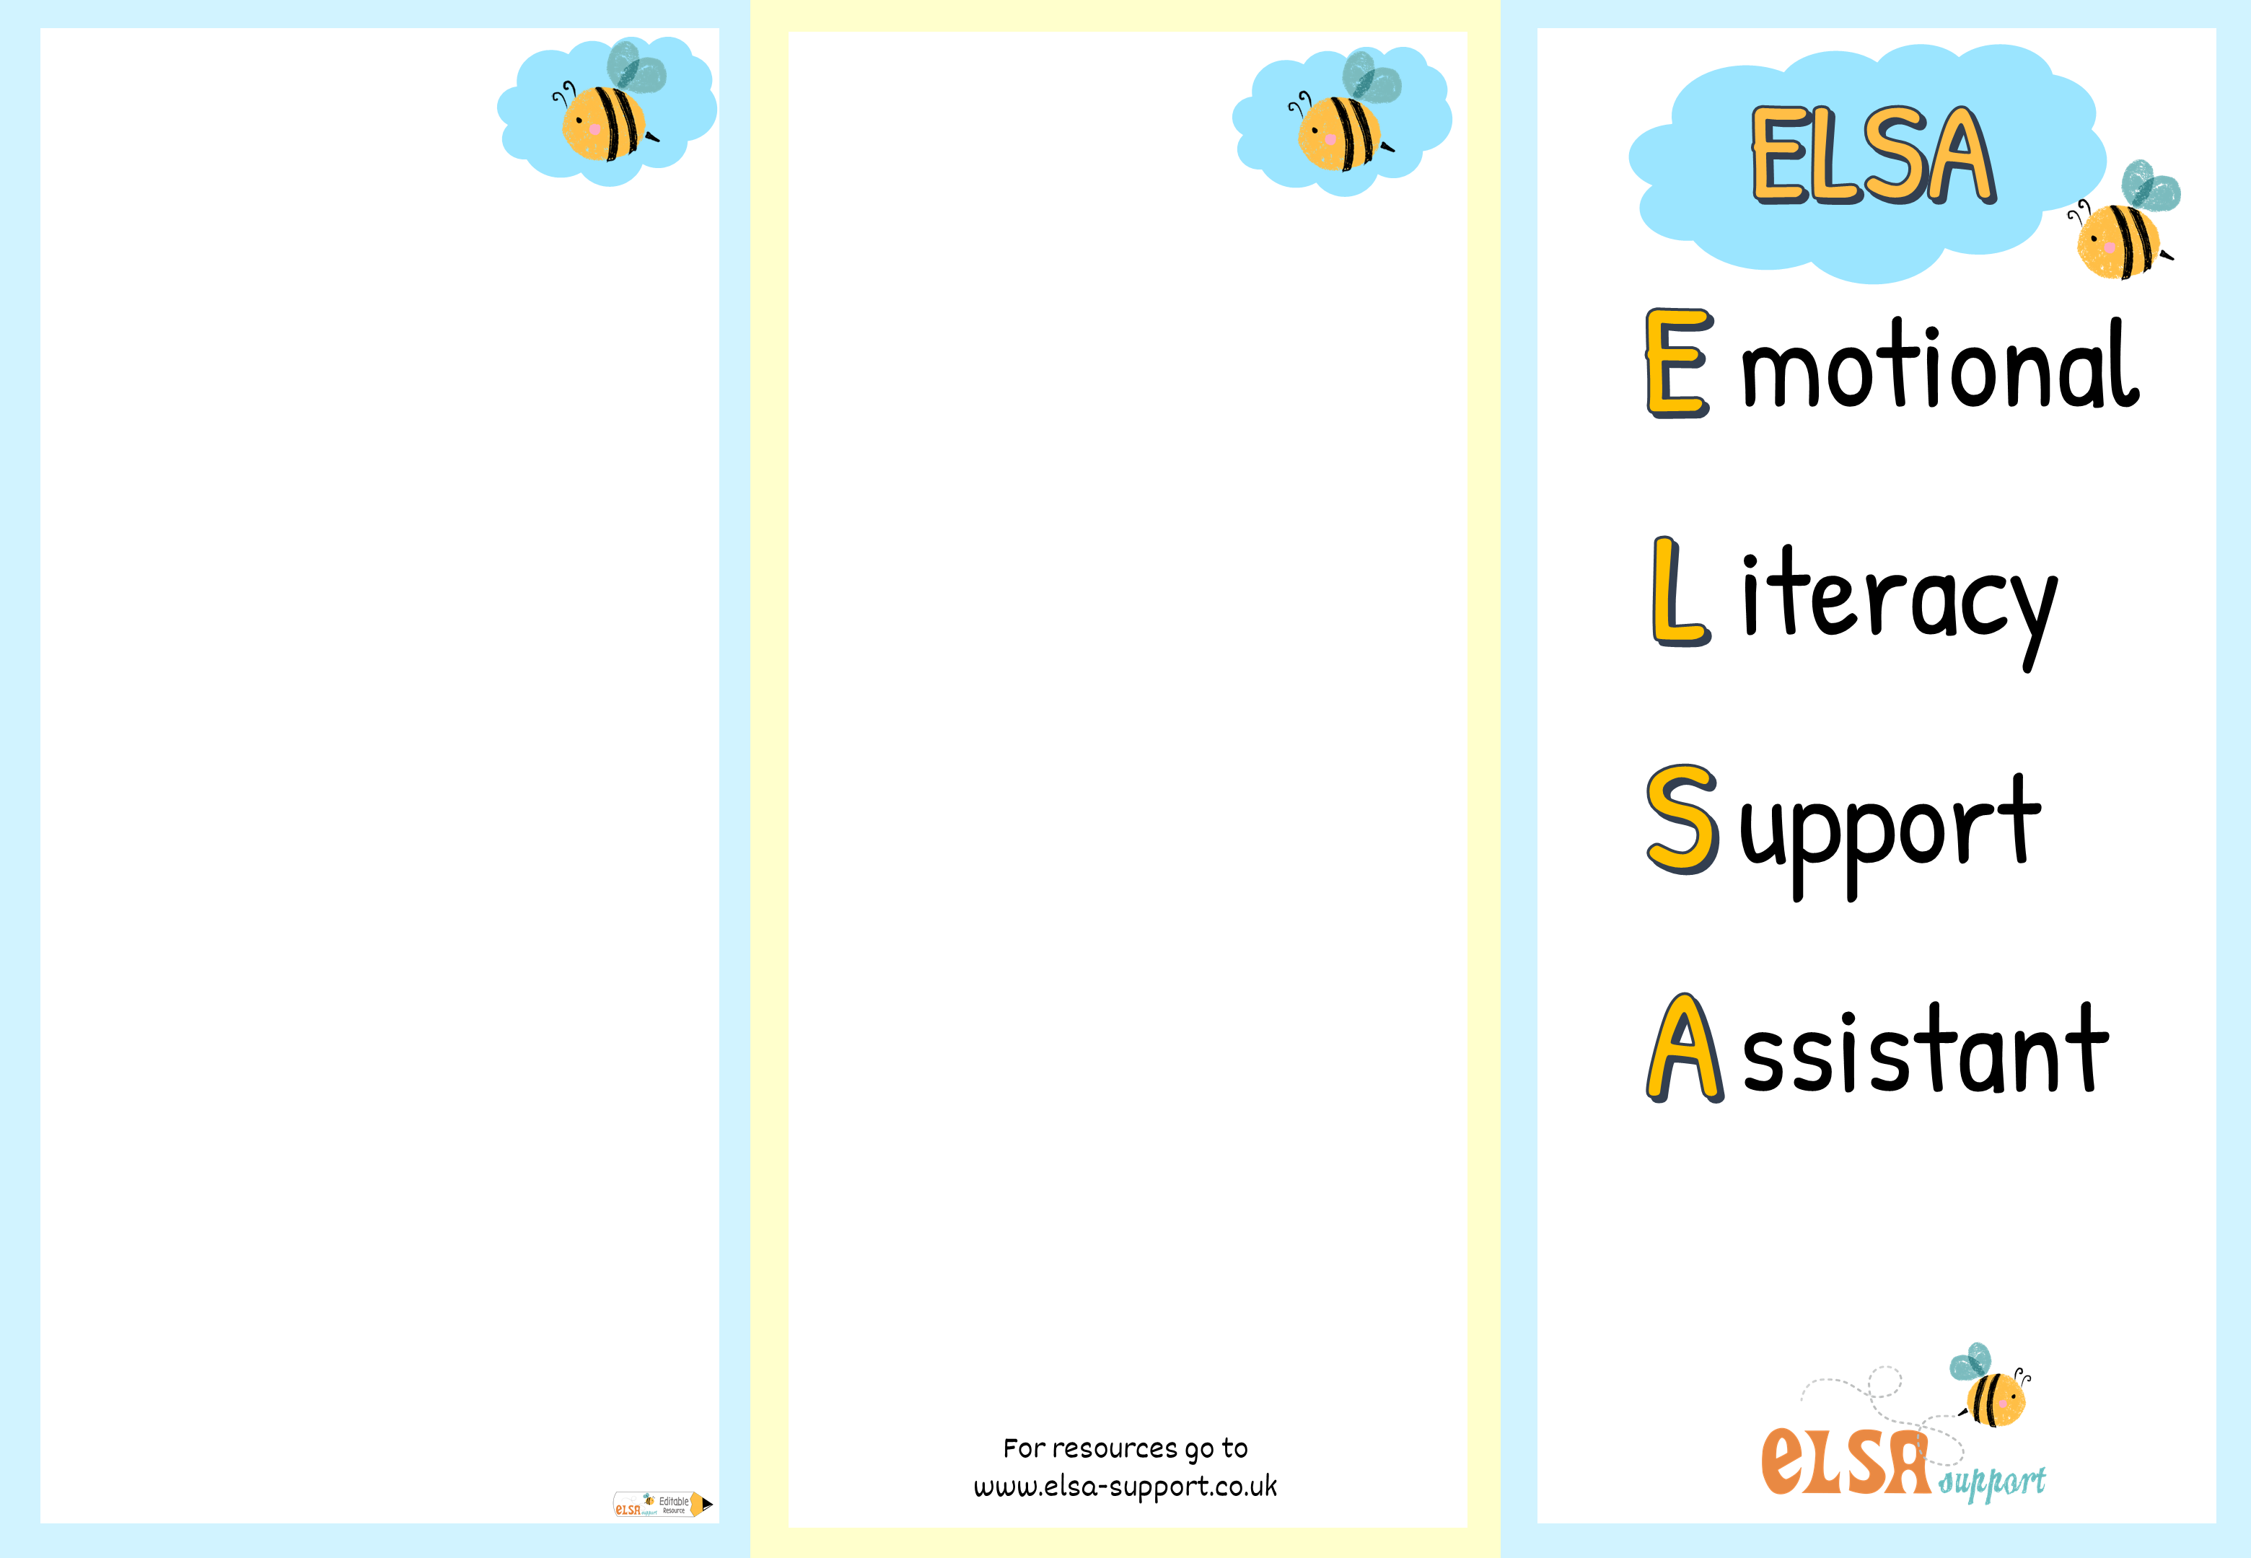

ELSAs can help with
Who to contact
Loss and bereavement
Emotional literacy
Self esteem
Social skills
Friendship issues
Relationships
Managing strong feelings
Anxiety
Bullying
Conflict
Emotional regulation
Growth mindset
Social stories
If you think your child could benefit from ELSA sessions then please contact:
The Inclusion Team
Email:admin@barnwood.gloucs.sch.uk
Tel: 01452 617135
Mrs Lisa Williams

Slide 2

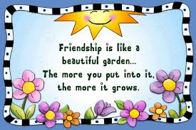
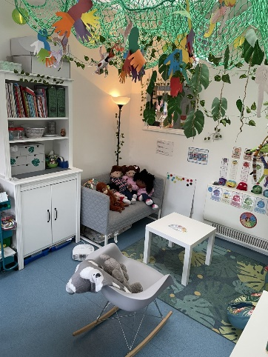
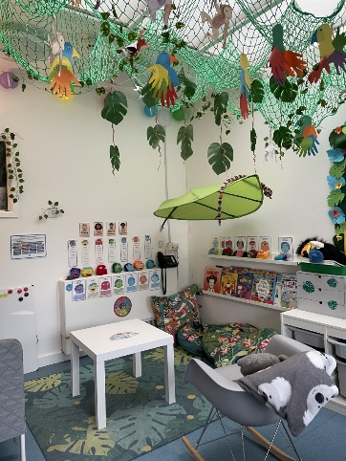
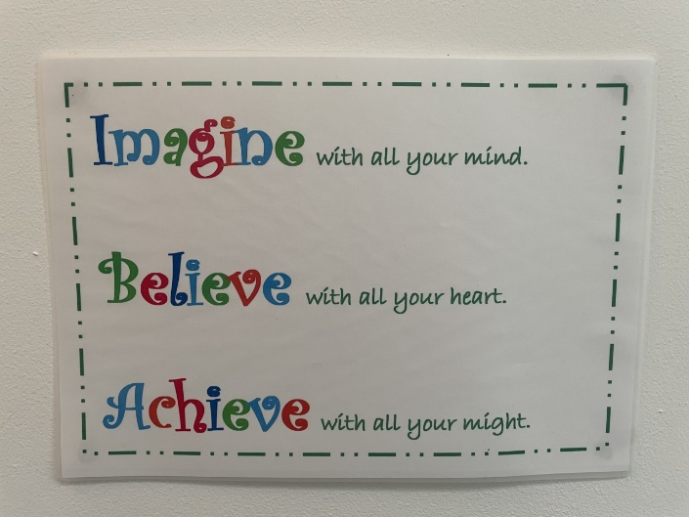
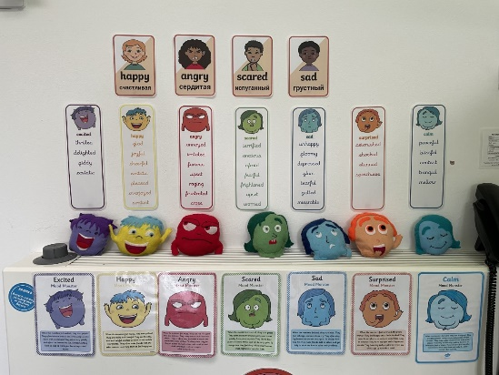
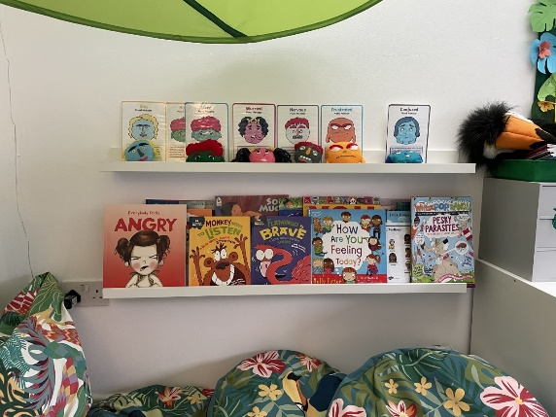
What is an ELSA?
Group Session
Individual Session
ELSAs are Emotional Literacy Support Assistants. They are a specialist teaching assistant with a wealth of experience of working with children. ELSAs are trained and regularly supervised by the Educational Psychologists.
An ELSA is a warm and caring person who wants to help your child feel happy in school and to reach their potential educationally.
Their aim is to build your child’s emotional development and help them cope with life’s challenges.
The ELSA will help your child to find solutions and strategies to cope with, and hopefully overcome, any problems they may have.
Please do talk to your child’s class teacher or a member of the Inclusion Team: Mrs Knight, Mrs Griffiths or Mrs Williams if you have any concerns about your child that may impact their learning.
What does that does that look like here at Barnwood?
We will ask for a Pupil and Parent Voice to be completed as a baseline so we can set targets and build a bespoke programme for your child.
Your child will be offered 6 to 12 sessions on a weekly basis initially and they can vary in time according to the age of your child. They will take place in The Snug (our nurture room).
Sometimes children benefit from working together to solve a problem such as friendship issues.
As with the individual sessions, your child will be offered 6 to 12 sessions initially, and again, can vary in time according to age. These groups are sometimes run at lunch time in the form of a ‘club’. The sessions are always fun, creative and interactive.
The sessions are always fun and we work creatively and therapeutically. For example, with the use of workbooks, stories, toys, puppets, art, Lego and drawing.
The Snug

