Slide 1


Set 1 Phonics – Speed Sounds
Stretchy sounds are shown as one sound repeated lots of times – your child can tell you.
Bouncy sounds are shown using a comma between sounds – you child can tell you.
Do not add an ‘ughh’ to the end of a sound – keep it pure for example ‘mmmm’ not m-ugh’.
Sometimes, two letter sounds join together and make friends to become one new sound. In set 1 you will meet some of these. We call two sounds like this a diagraph. Spot them in your reading.

Slide 2
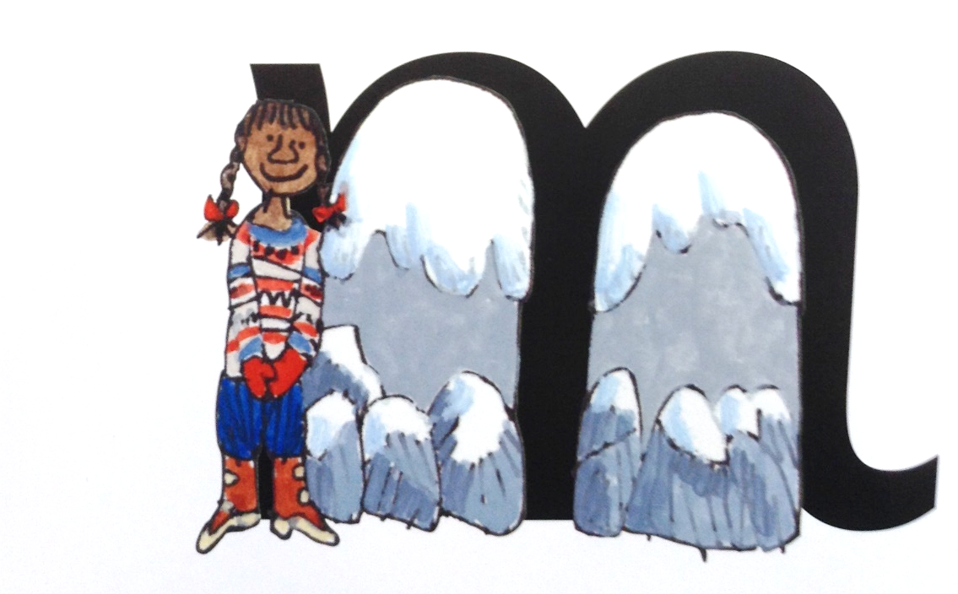
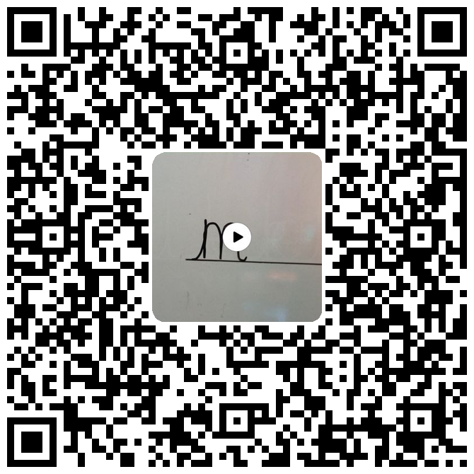
mmmm….
Up to the top and stop, down Maisy mountain, mountain
m

Slide 3


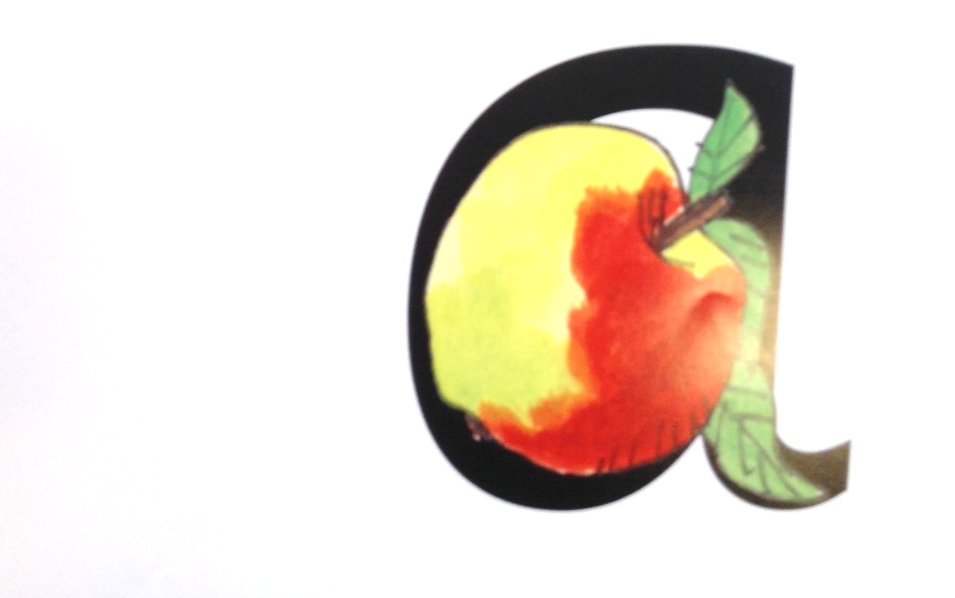
a, a, a, a…
Up to the top and stop, back around the apple and down the leaf
a

Slide 4

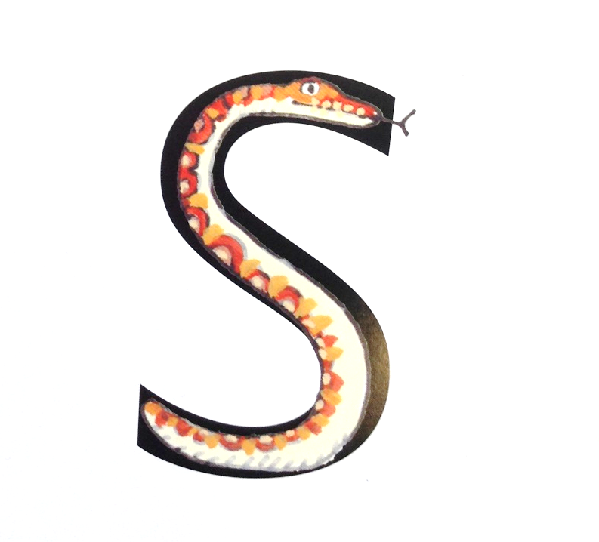
sssss….
Up to the top and stop, slither down the snake and away we go
s

Slide 5

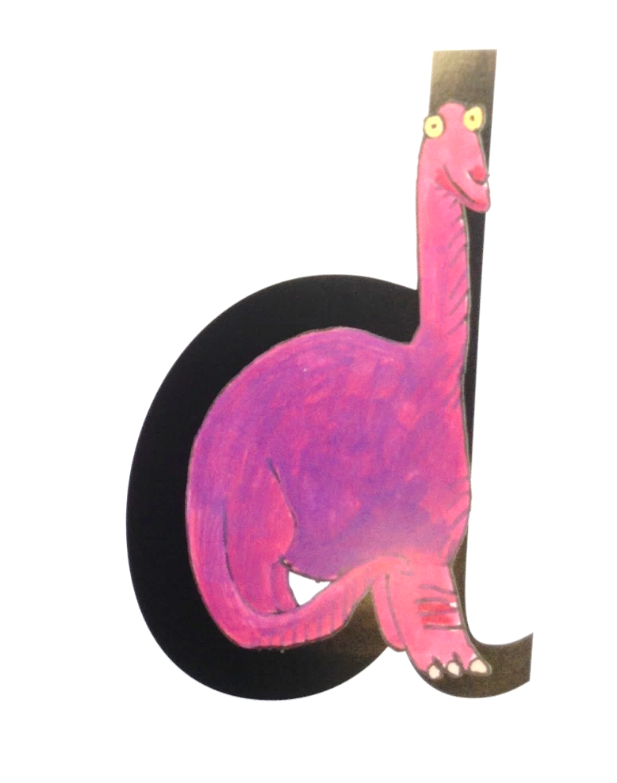
d, d, d, d…
Up to the top and stop, back round the dinosaurs bottom, up his tall neck and down to his feet.
d

Slide 6

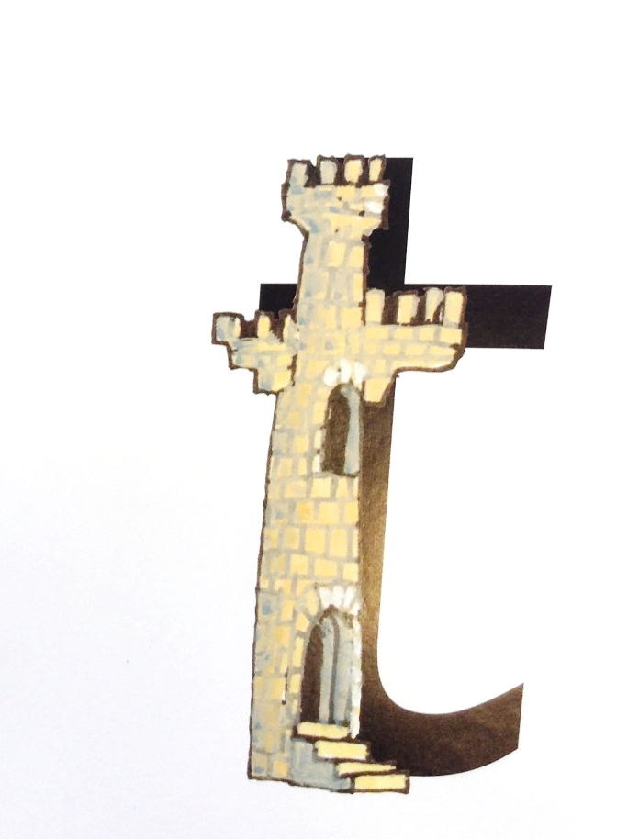
t, t, t, t…
Up to the top and stop, down the tall tower, across the tower
t

Slide 7
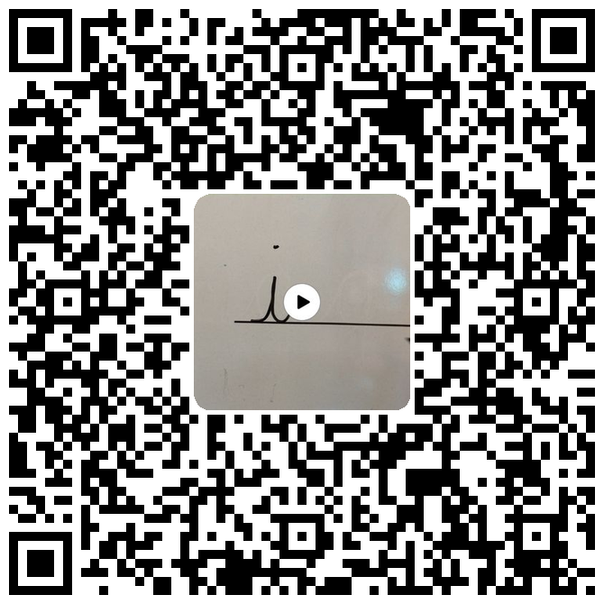
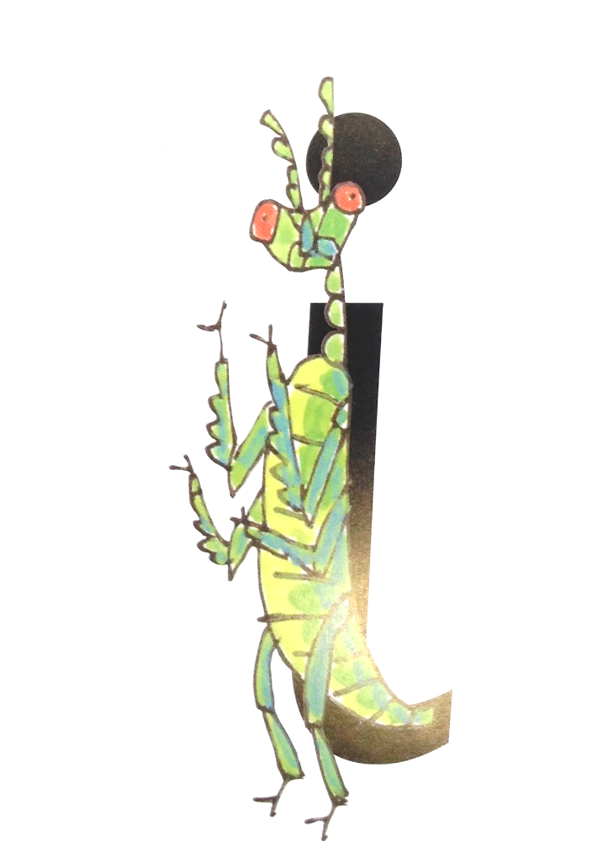
i, i, i, i…
Up to the top and stop, down the insect’s body and dot for his head
i

Slide 8

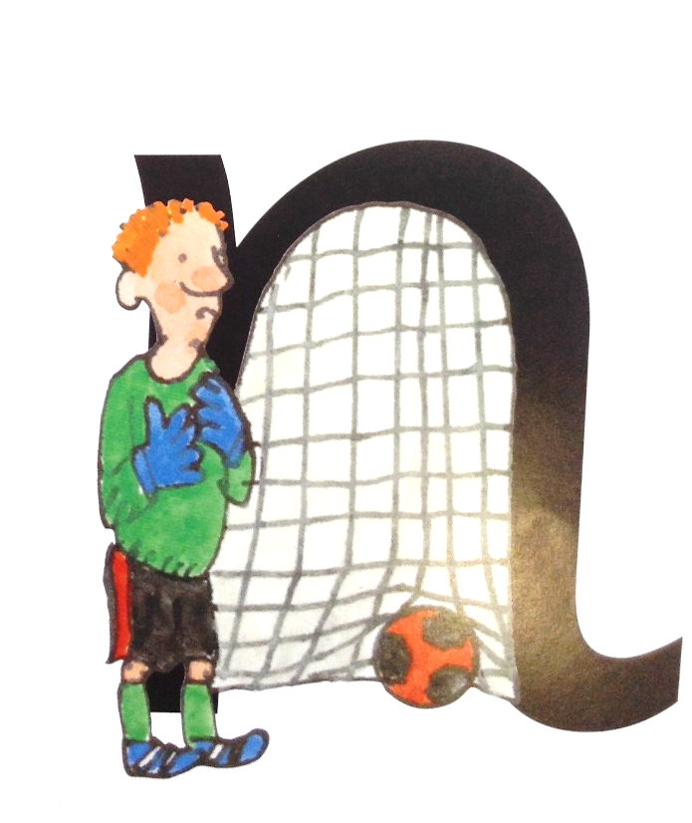
nnnn….
Up to the top and stop, down Nobby and over his net, away we go
n

Slide 9

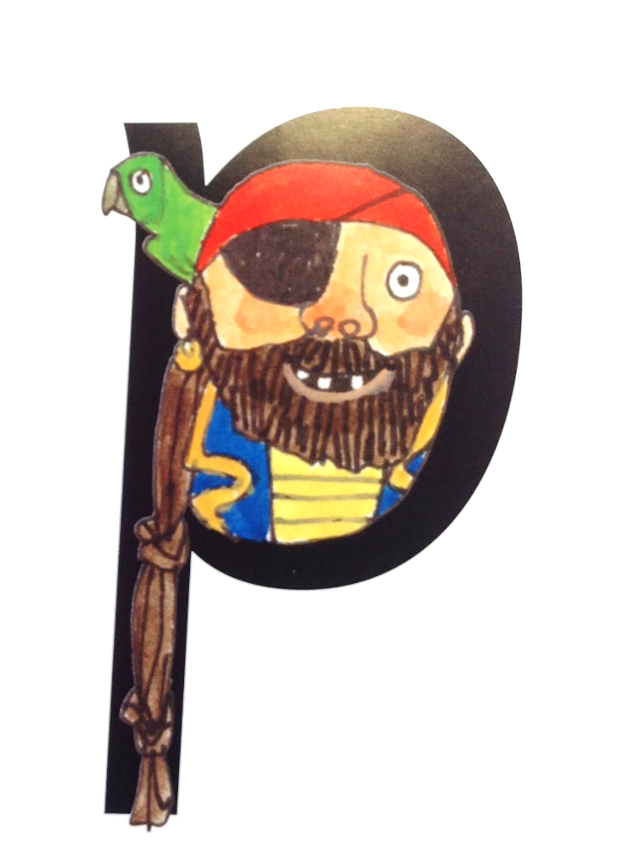
p, p, p, p….
Up to the top and stop, down the pirate’s plait, up round his face and away we go
p

Slide 10
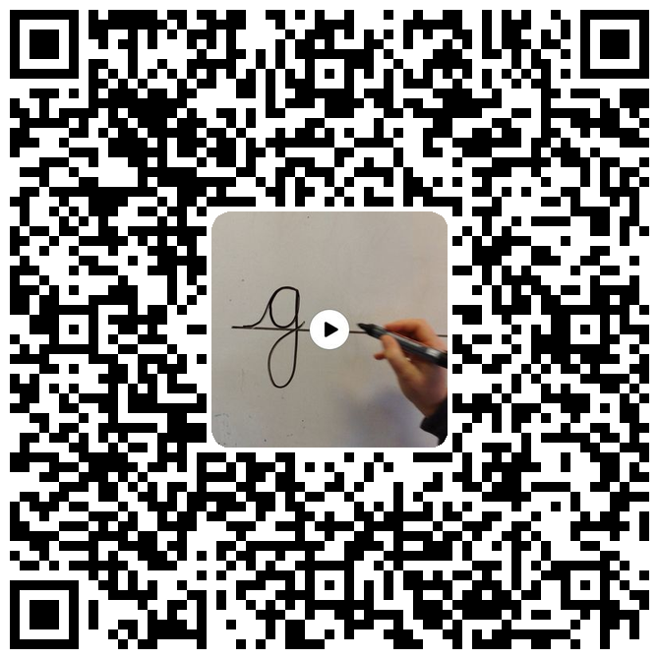
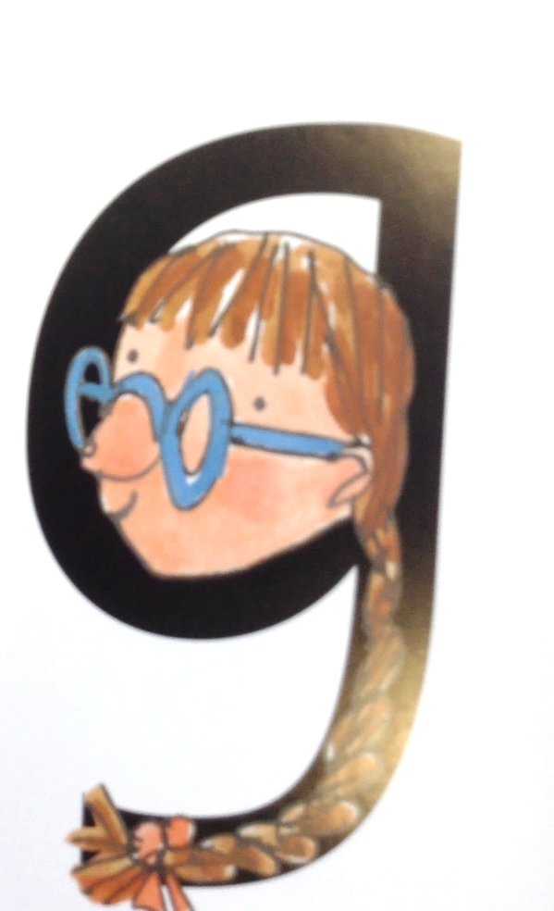
g, g, g, g…
Up to the top and stop, back round the girl’s face, down her hair and give her a curl.
g

Slide 11

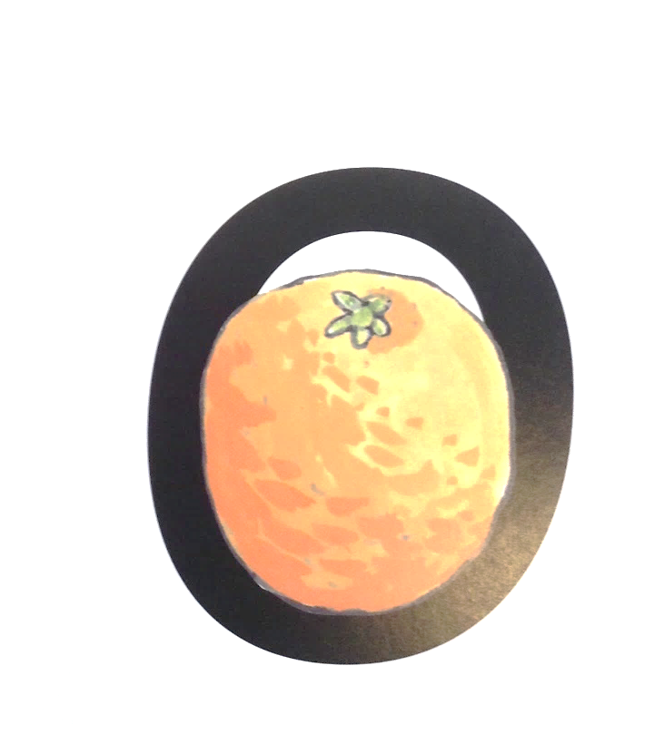
o, o, o, o….
Up to the top and stop, backwards, all around the orange and away we go
o

Slide 12
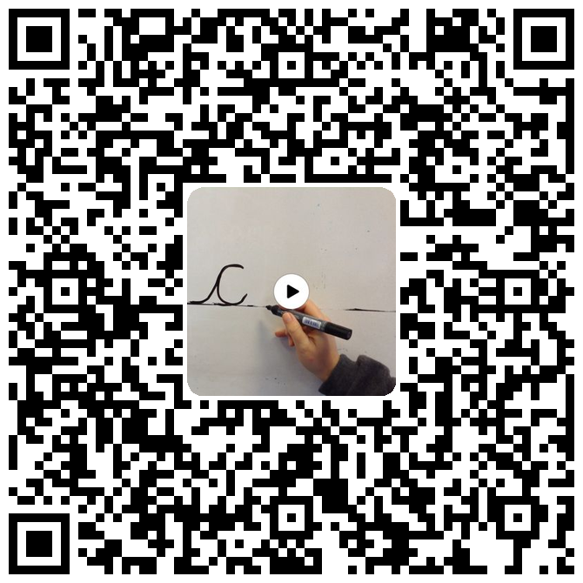
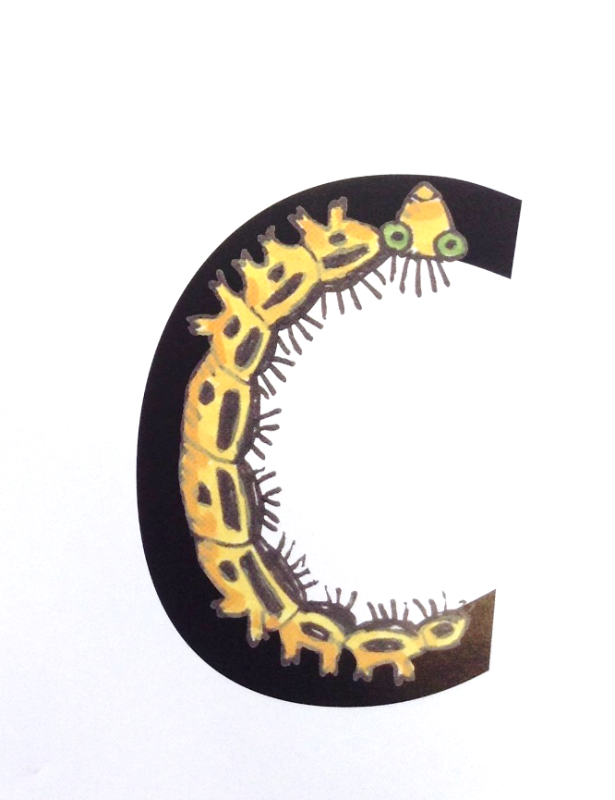
c, c, c, c….
Up to the top and stop, curl back around the caterpillar
c

Slide 13

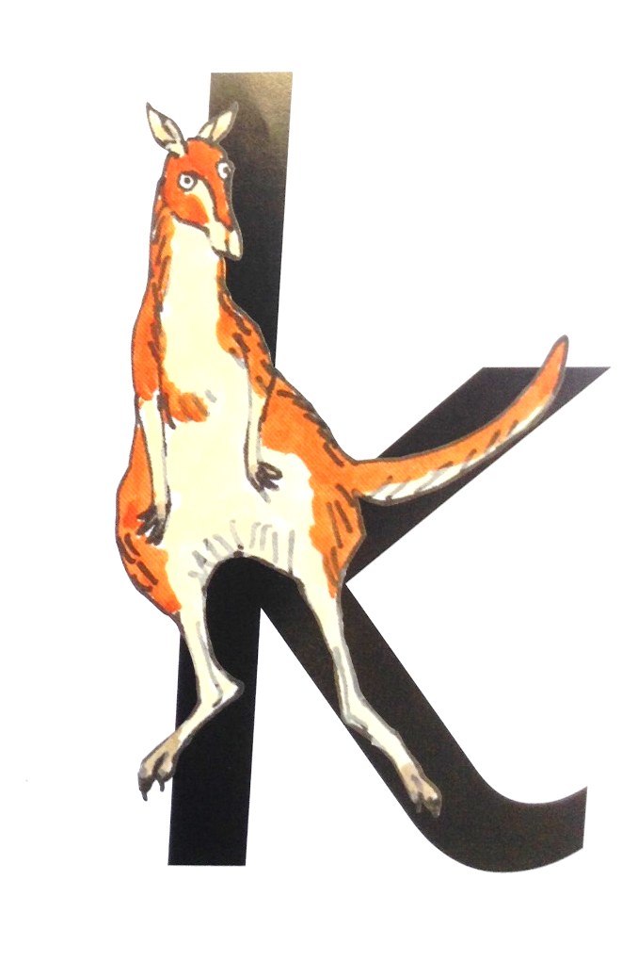
k, k, k, k…
Up to the top and stop, down the kangaroo’s body, up round his tail and kick out his leg
k

Slide 14

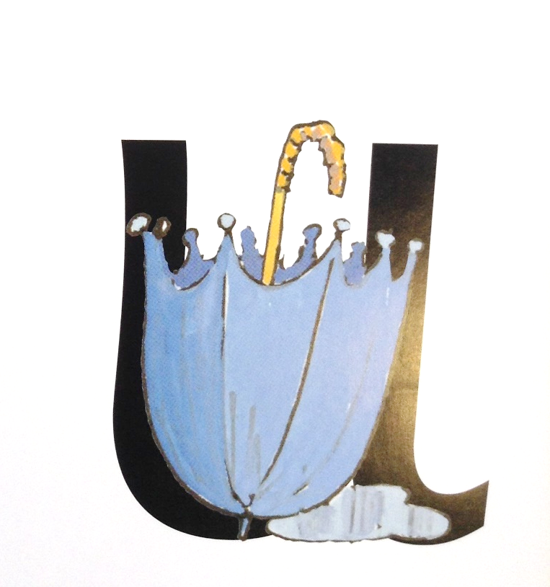
u, u, u, u…
Up to the top and stop, down and under, up to the top and down to draw the puddle.
u

Slide 15

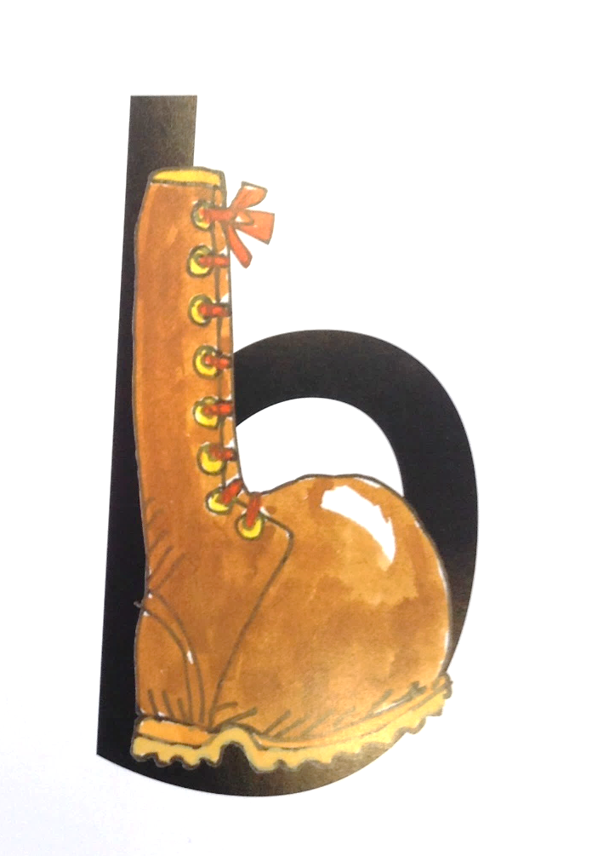
b, b, b, b….
Up to the top and stop, down the laces to the heal, over the toe and away we go
b

Slide 16
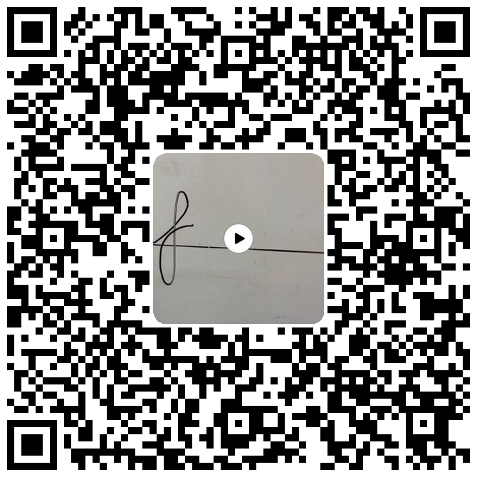
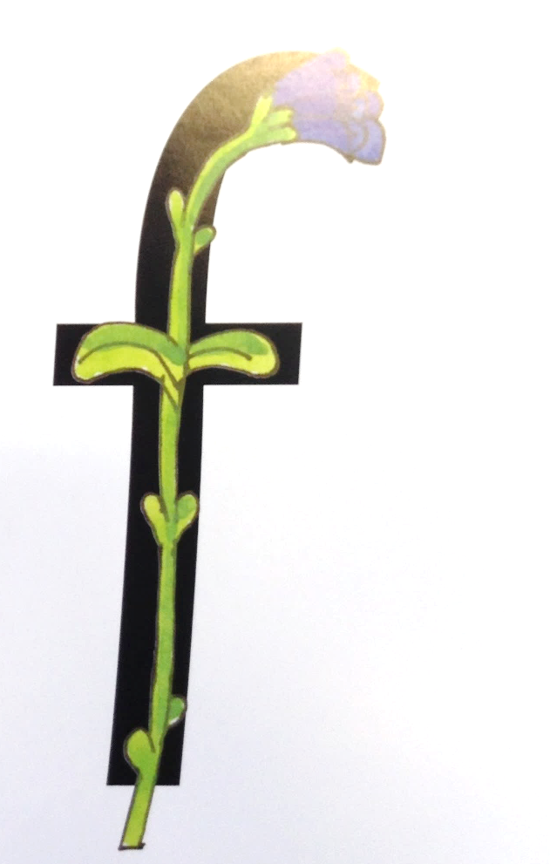
fffff…..
Up to the top loop down the stem and loop back to draw the leaves
f

Slide 17
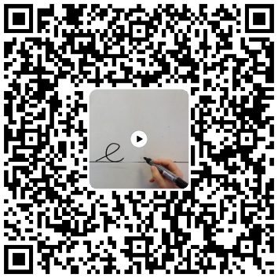
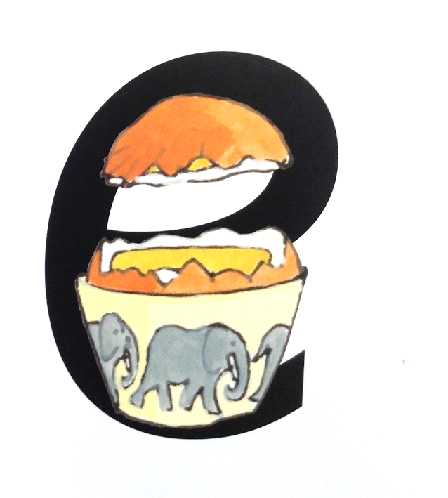
e, e, e, e… start on the line, lift off the top and scoop out the egg
e

Slide 18

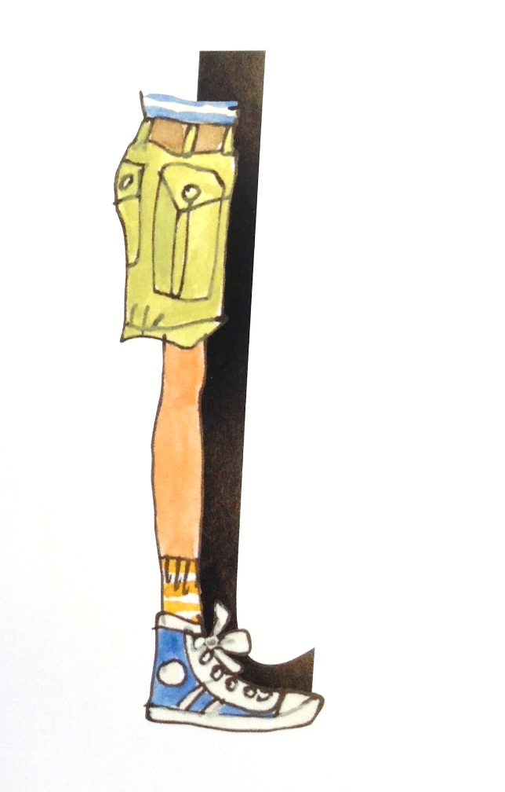
lllllllll….
Up to the top and stop, down the long leg, away we go
l

Slide 19

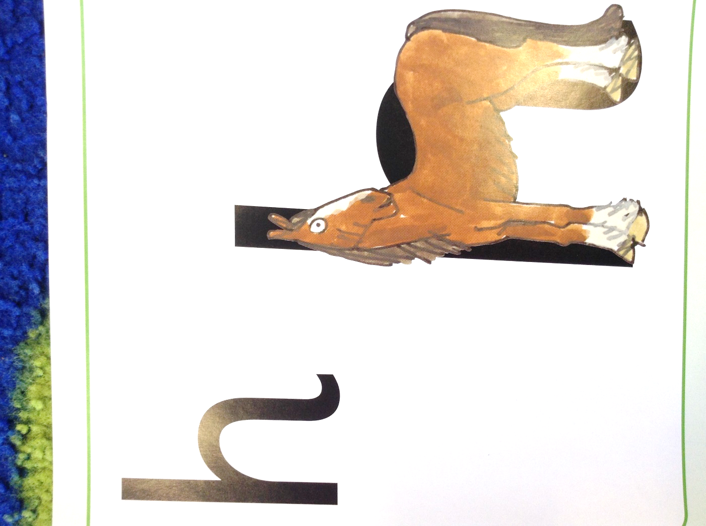
h, h, h, h…
Up to the top and stop, down the horse’s head to his hooves, over his back and away we go
h

Slide 20

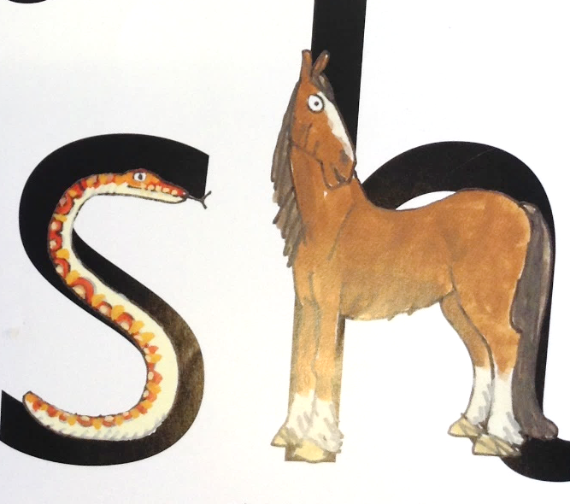
Shhhhhh…. says the horse to the hissing snake!
sh

Slide 21

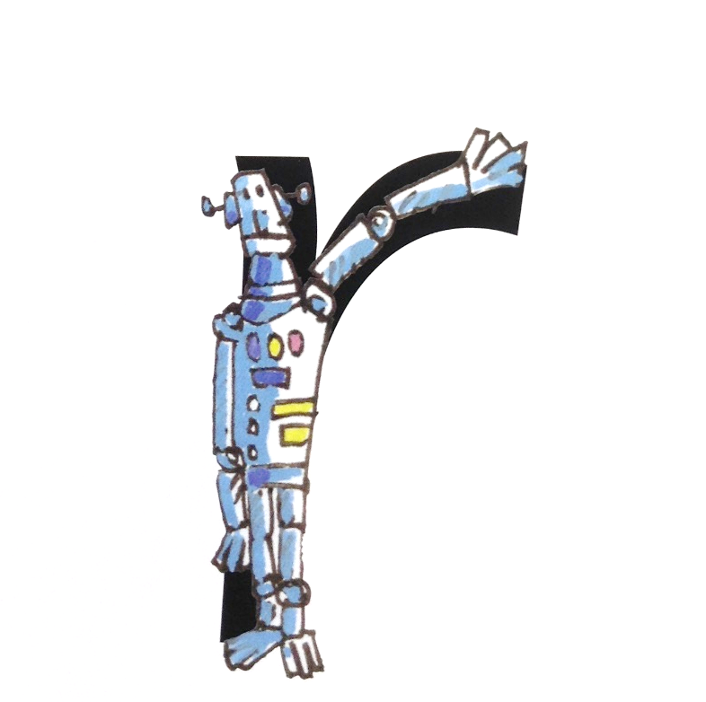
rrrrrrr….
Up to the top and stop, down the robot’s back and curl over his arm
r

Slide 22
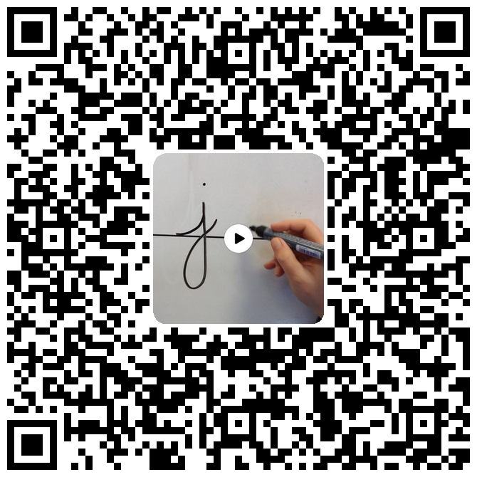
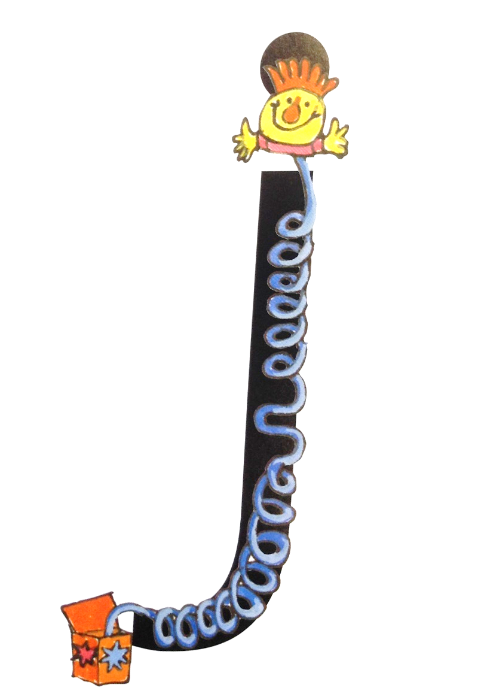
j, j, j, j…
Up to the top and stop, down the jack-in-a-box, curl and dot
j

Slide 23

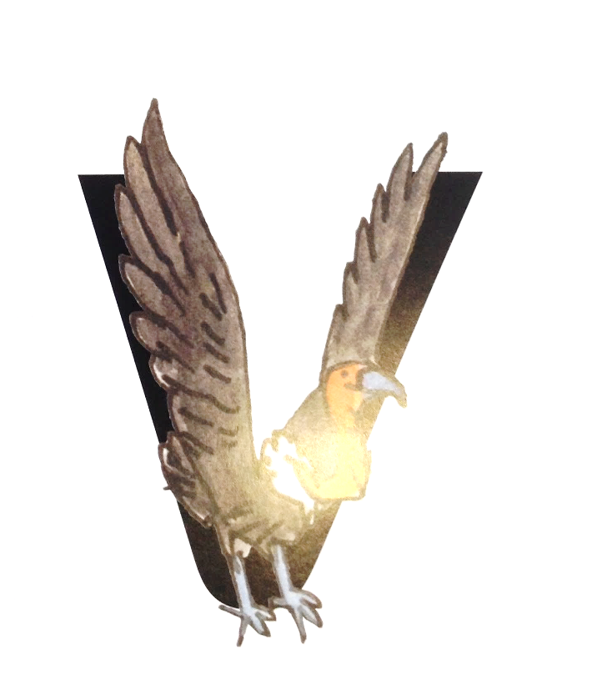
vvvv….
Up to the top and stop, down a wing, up a wing and away we go
v

Slide 24
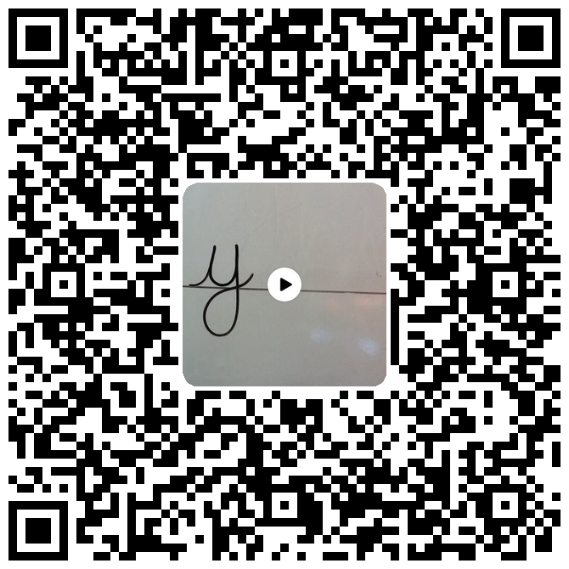
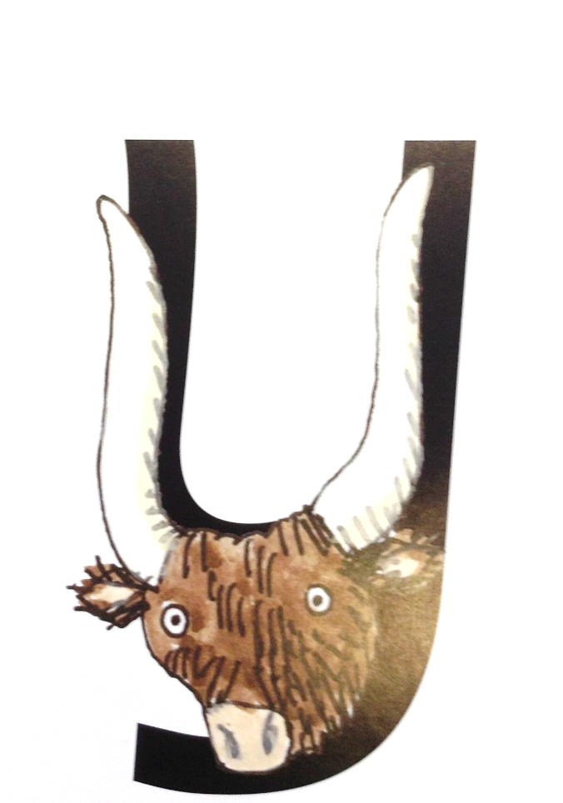
y, y, y, y…
Up to the top and stop, down a horn, up a horn and curl under his head, away we go
y

Slide 25

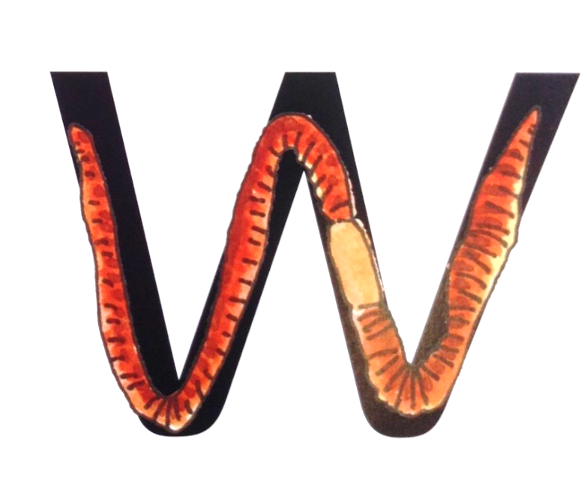
w, w, w, w….
Up to the top and stop, down up, down up and away we go.
w

Slide 26
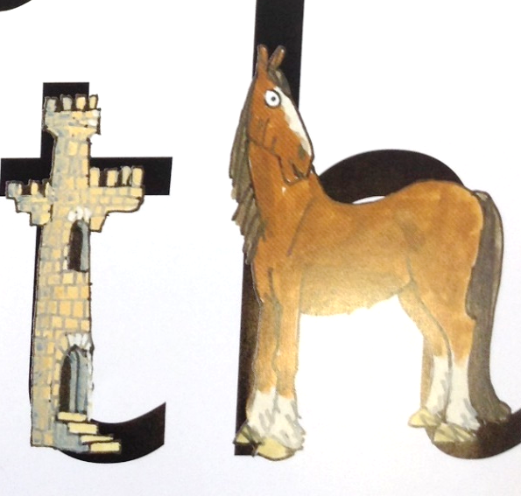
thhhhh…the princess in the tower is rescued by the horse, she says thankyou!”
th

Slide 27
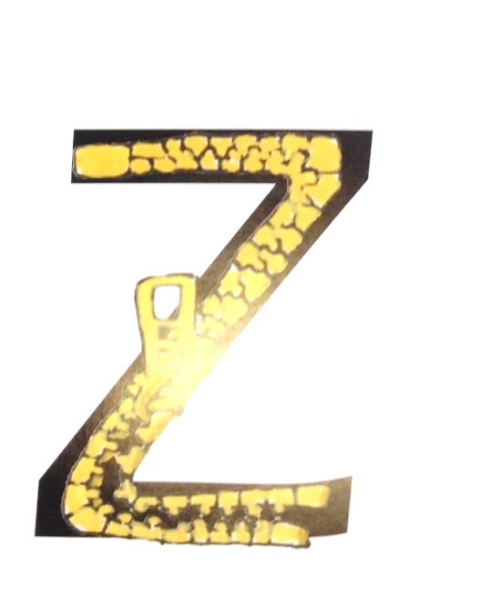
zzzzz…
Up to the top and stop, zig, zag, zig, curl under away we go
z

Slide 28
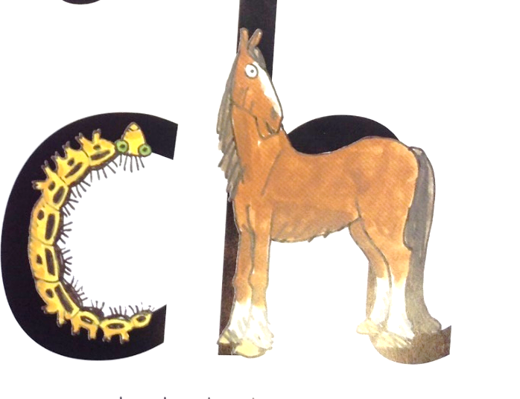
ch, ch, ch, ch… the caterpillars hairs go up the horses nose ch, ch, ch, choo!
ch

Slide 29

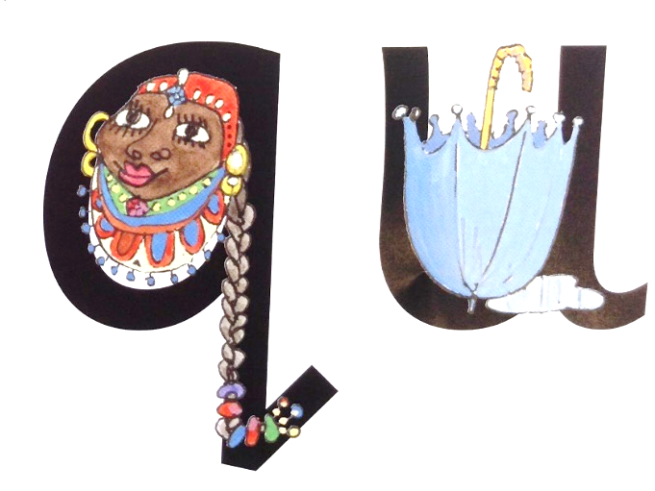
qu, qu, qu, qu…
Up to the top and stop, back round the queen’s face, up past her earrings, straight down her hair and flick away we go
qu

Slide 30

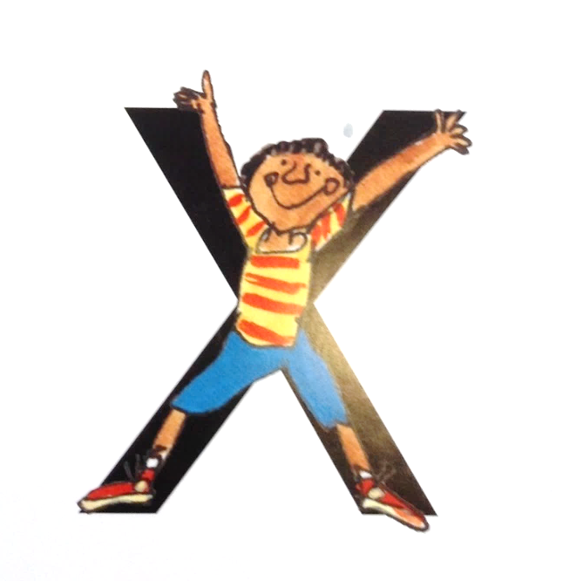
xxxx….
Up to the top and stop, curl down an arm and a leg then repeat on the other side.
x

Slide 31
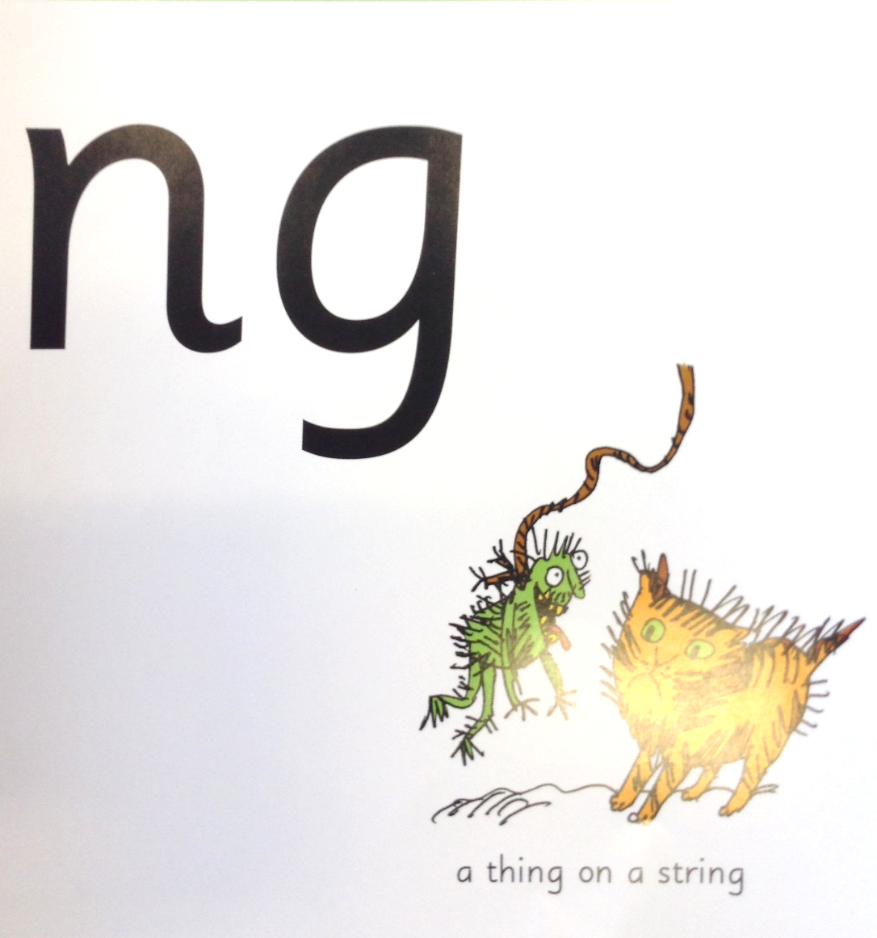
ng, ng, ng, ng, a thing on a string
ng

Slide 32
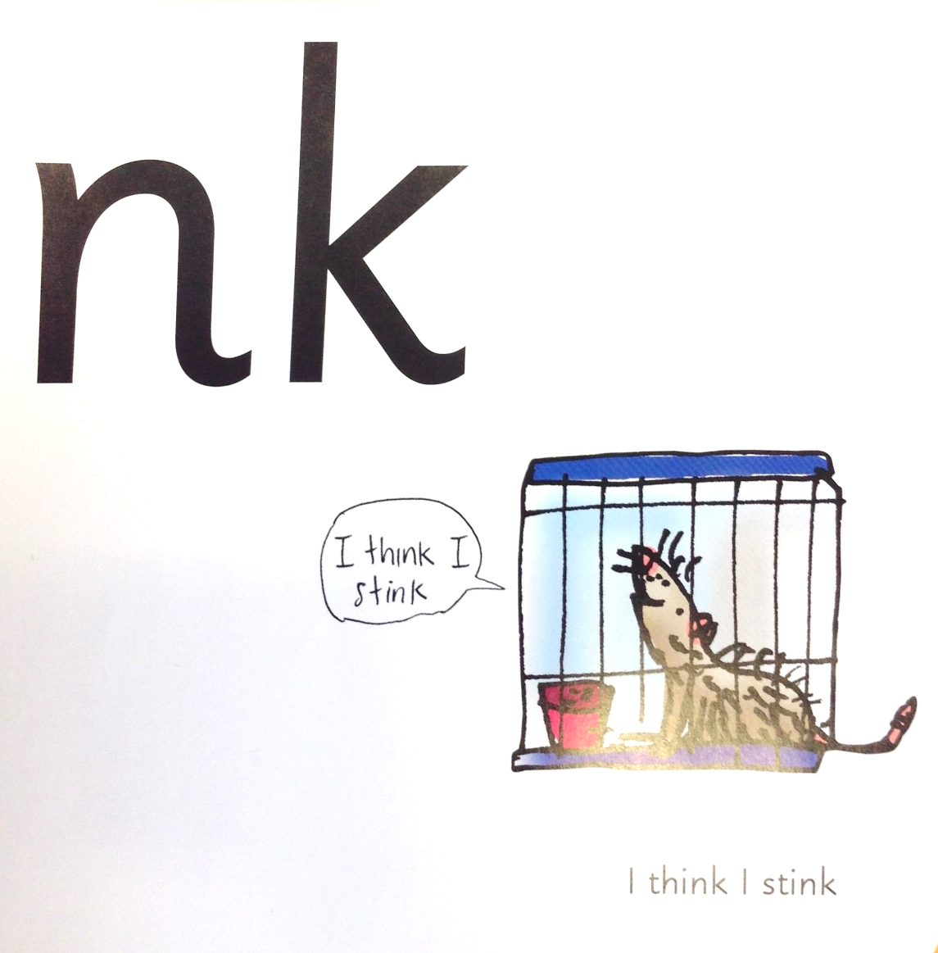
nk, nk, nk, nk, “I think I stink!”
nk

